Slide 1
Lab Feedback
500085 - 2D Computer Graphics and Simulation

Slide 2
Enter the Matrix
500085 – 2D Computer Graphics and Simulation

Slide 3
Agenda
Creating Matrices that can:
Translate
Rotate
Scale
Identity

Slide 4
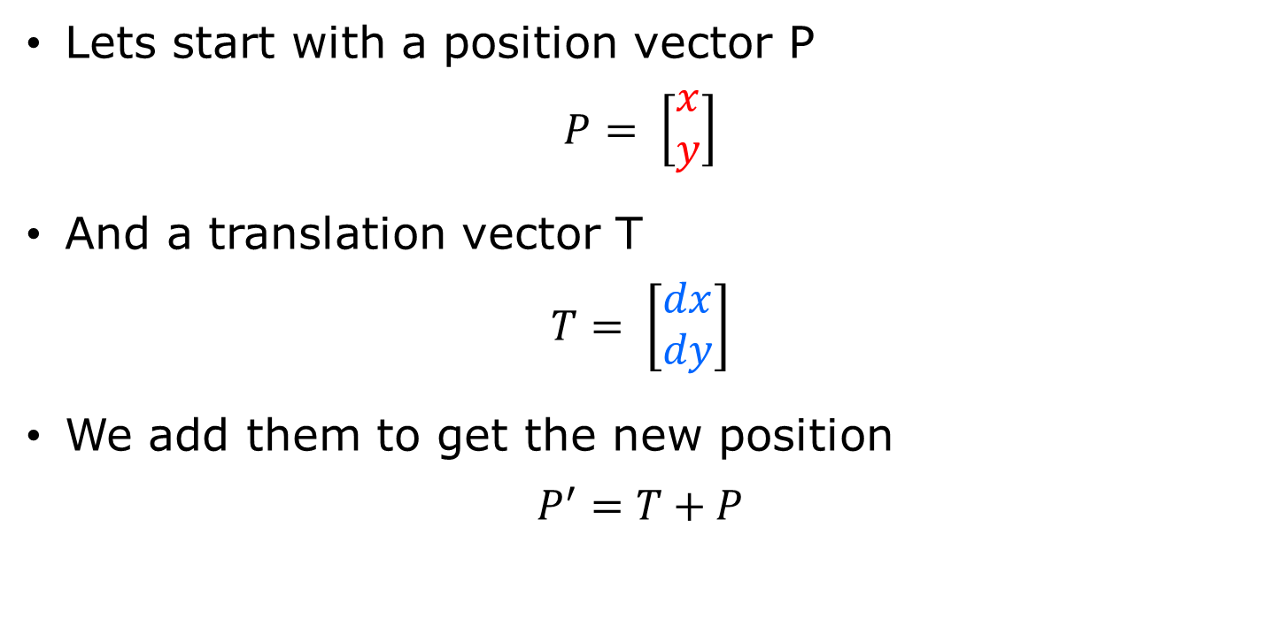
Translate
Lets start with a position vector P
$$P= \left[\begin{matrix}x \\ y\end{matrix}\right]$$
And a translation vector T
$$T= \left[\begin{matrix}dx \\ dy\end{matrix}\right]$$
We add them to get the new position
$$P^{′}=T+P$$

Slide 5

Translate
$$P^{′}=\left[\begin{matrix}x′ \\ y′\end{matrix}\right]=T+P=\left[\begin{matrix}dx \\ dy\end{matrix}\right]+\left[\begin{matrix}x \\ y\end{matrix}\right]$$
$$\left[\begin{matrix}dx+x \\ dy+y\end{matrix}\right]=\left[\begin{matrix}x′ \\ y′\end{matrix}\right]$$
$$\left[\begin{matrix}dx+x \\ dy+y\end{matrix}\right]=\left[\begin{matrix}x′ \\ y′\end{matrix}\right]$$

Slide 6
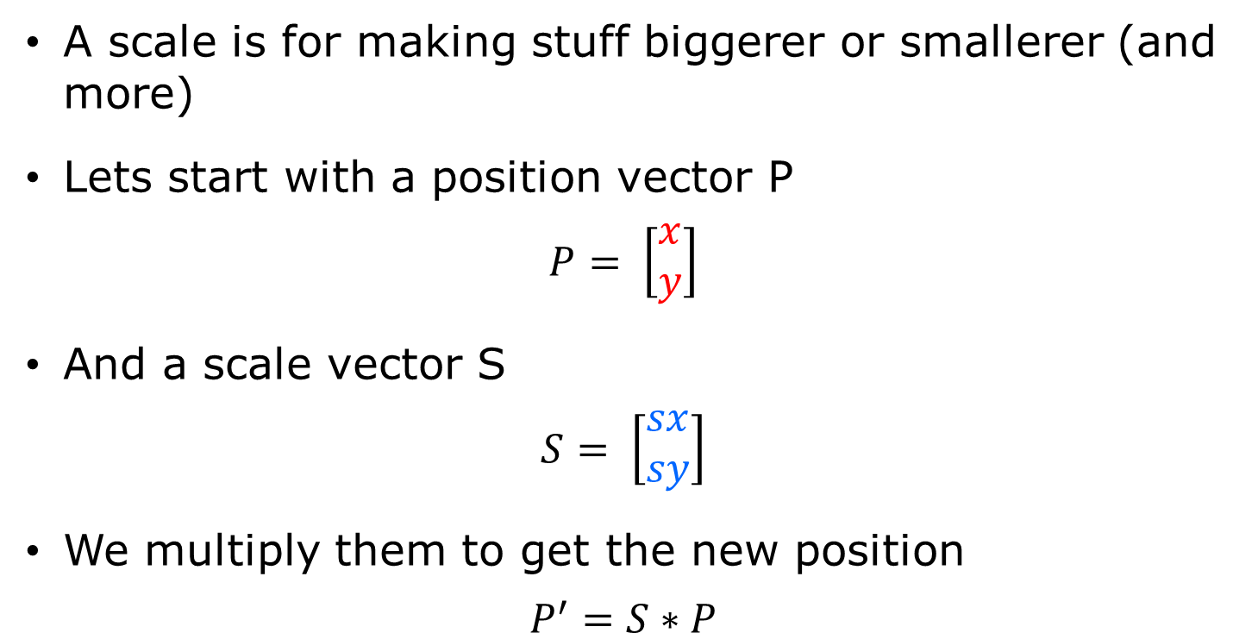
Scale
A scale is for making stuff biggerer or smallerer (and more)
Lets start with a position vector P
$$P= \left[\begin{matrix}x \\ y\end{matrix}\right]$$
And a scale vector S
$$S= \left[\begin{matrix}sx \\ sy\end{matrix}\right]$$
We multiply them to get the new position
$$P^{′}=S∗P$$

Slide 7

Scale
We multiply them to get the new position
$$P^{′}=\left[\begin{matrix}x′ \\ y′\end{matrix}\right]=S∗P=\left[\begin{matrix}sx \\ sy\end{matrix}\right]∗\left[\begin{matrix}x \\ y\end{matrix}\right]$$
$$\left[\begin{matrix}sx∗x \\ sy∗y\end{matrix}\right]=\left[\begin{matrix}x′ \\ y′\end{matrix}\right]$$
$$\left[\begin{matrix}sx∗x \\ sy∗y\end{matrix}\right]=\left[\begin{matrix}x′ \\ y′\end{matrix}\right]$$

Slide 8
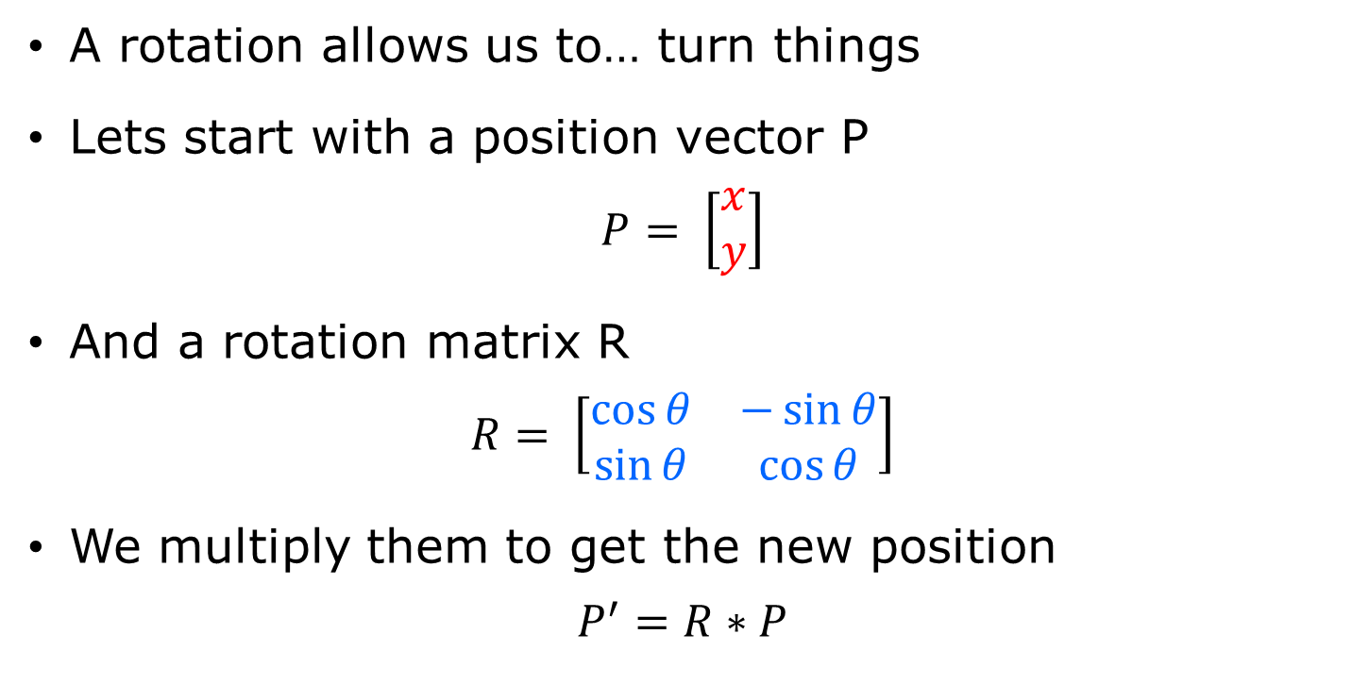
Rotate
A rotation allows us to… turn things
Lets start with a position vector P
$$P= \left[\begin{matrix}x \\ y\end{matrix}\right]$$
And a rotation matrix R
$$R= \left[\begin{matrix}\cos{θ} & −\sin{θ} \\ \sin{θ} & \cos{θ}\end{matrix}\right]$$
We multiply them to get the new position
$$P^{′}=R∗P$$

Slide 9
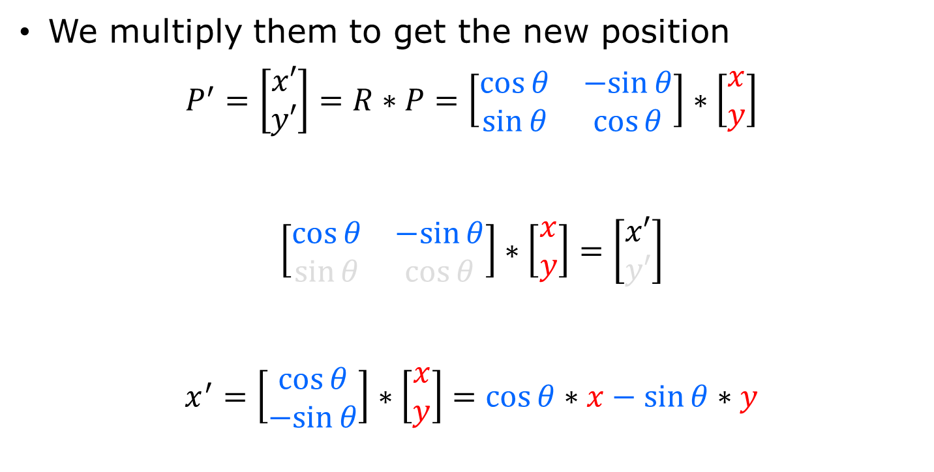
Rotate
We multiply them to get the new position
$$P^{′}=\left[\begin{matrix}x′ \\ y′\end{matrix}\right]=R∗P=\left[\begin{matrix}\cos{θ} & −sin{θ} \\ \sin{θ} & \cos{θ}\end{matrix}\right]∗\left[\begin{matrix}x \\ y\end{matrix}\right]$$
$$\left[\begin{matrix}\cos{θ} & −sin{θ} \\ \sin{θ} & \cos{θ}\end{matrix}\right]∗\left[\begin{matrix}x \\ y\end{matrix}\right]=\left[\begin{matrix}x′ \\ y′\end{matrix}\right]$$
$$x^{′}=\left[\begin{matrix}\cos{θ} \\ −sin{θ}\end{matrix}\right]∗\left[\begin{matrix}x \\ y\end{matrix}\right]=cos{θ}∗x−\sin{θ}∗y$$

Slide 10
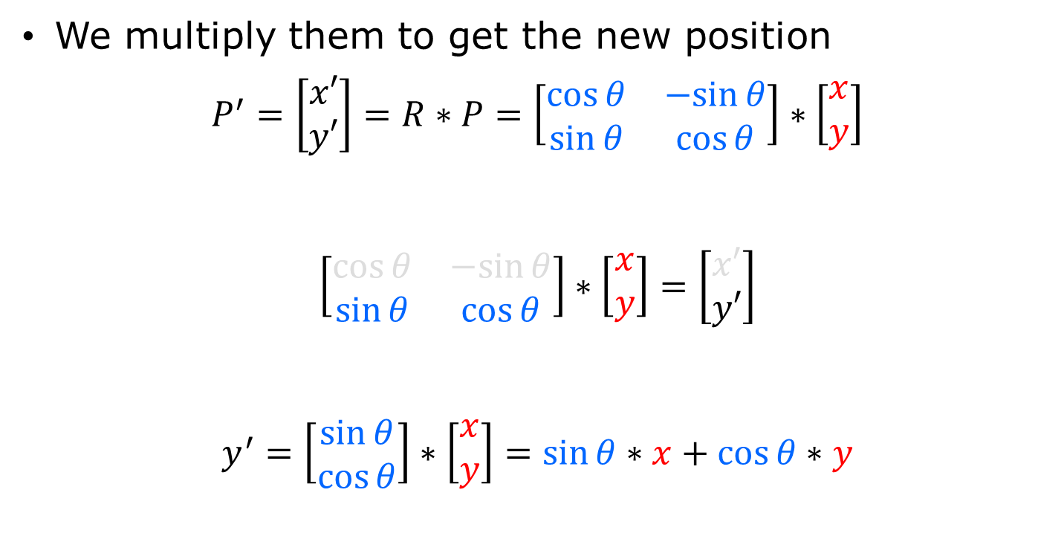
Rotate
We multiply them to get the new position
$$P^{′}=\left[\begin{matrix}x′ \\ y′\end{matrix}\right]=R∗P=\left[\begin{matrix}\cos{θ} & −sin{θ} \\ \sin{θ} & \cos{θ}\end{matrix}\right]∗\left[\begin{matrix}x \\ y\end{matrix}\right]$$
$$\left[\begin{matrix}\cos{θ} & −sin{θ} \\ \sin{θ} & \cos{θ}\end{matrix}\right]∗\left[\begin{matrix}x \\ y\end{matrix}\right]=\left[\begin{matrix}x′ \\ y′\end{matrix}\right]$$
$$y^{′}=\left[\begin{matrix}\sin{θ} \\ \cos{θ}\end{matrix}\right]∗\left[\begin{matrix}x \\ y\end{matrix}\right]=sin{θ}∗x+\cos{θ}∗y$$

Slide 11

Rotate
Incidentally this may look familiar
$$x^{′}=\cos{θ}∗x−\sin{θ}∗y$$
$$y^{′}=\sin{θ}∗x+\cos{θ}∗y$$

Slide 12
Why not use matrices for everything then?
We need to use a matrix to do a rotation
So we can easily combine transformations lets try and use the same matrix for all our transformations

Slide 13
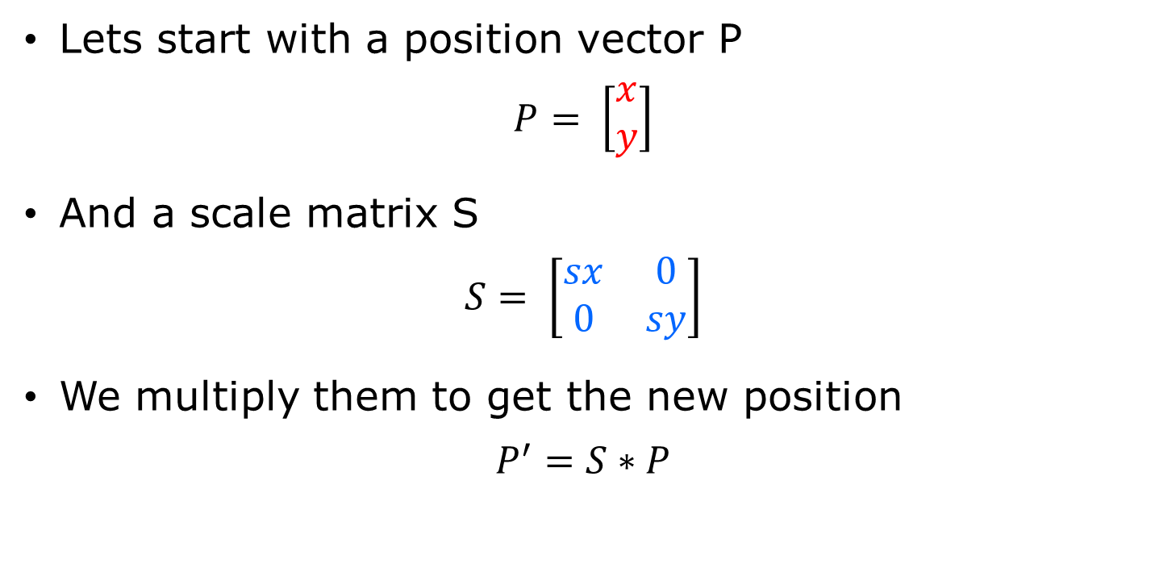
Scale
Lets start with a position vector P
$$P= \left[\begin{matrix}x \\ y\end{matrix}\right]$$
And a scale matrix S
$$S= \left[\begin{matrix}sx & 0 \\ 0 & sy\end{matrix}\right]$$
We multiply them to get the new position
$$P^{′}=S∗P$$

Slide 14
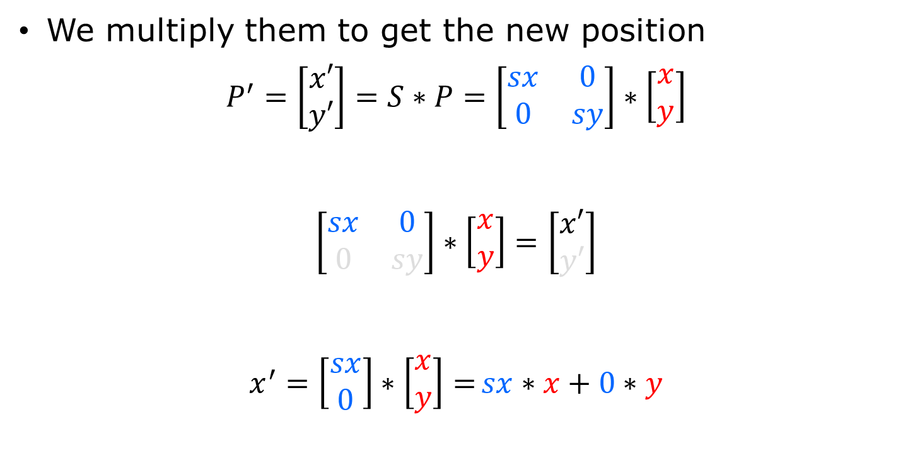
Scale
We multiply them to get the new position
$$P^{′}=\left[\begin{matrix}x′ \\ y′\end{matrix}\right]=S∗P=\left[\begin{matrix}sx & 0 \\ 0 & sy\end{matrix}\right]∗\left[\begin{matrix}x \\ y\end{matrix}\right]$$
$$\left[\begin{matrix}sx & 0 \\ 0 & sy\end{matrix}\right]∗\left[\begin{matrix}x \\ y\end{matrix}\right]=\left[\begin{matrix}x′ \\ y′\end{matrix}\right]$$
$$x^{′}=\left[\begin{matrix}sx \\ 0\end{matrix}\right]∗\left[\begin{matrix}x \\ y\end{matrix}\right]={sx}∗x+0∗y$$

Slide 15
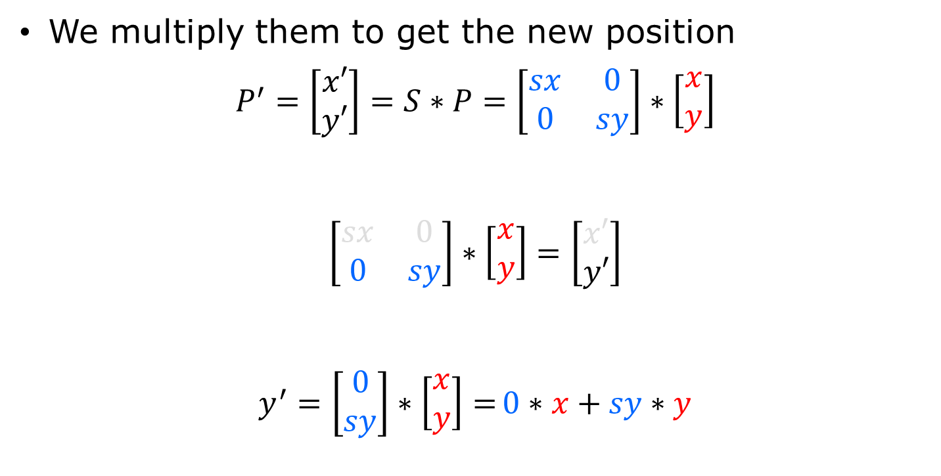
Scale
We multiply them to get the new position
$$P^{′}=\left[\begin{matrix}x′ \\ y′\end{matrix}\right]=S∗P=\left[\begin{matrix}sx & 0 \\ 0 & sy\end{matrix}\right]∗\left[\begin{matrix}x \\ y\end{matrix}\right]$$
$$\left[\begin{matrix}sx & 0 \\ 0 & sy\end{matrix}\right]∗\left[\begin{matrix}x \\ y\end{matrix}\right]=\left[\begin{matrix}x′ \\ y′\end{matrix}\right]$$
$$y^{′}=\left[\begin{matrix}0 \\ sy\end{matrix}\right]∗\left[\begin{matrix}x \\ y\end{matrix}\right]={0}∗x+sy∗y$$

Slide 16
So that is Rotate and Scale sorted, now Translate
This presents a problem
We can’t represent a 2D translation in a 2X2 matrix
So now what?

Slide 17
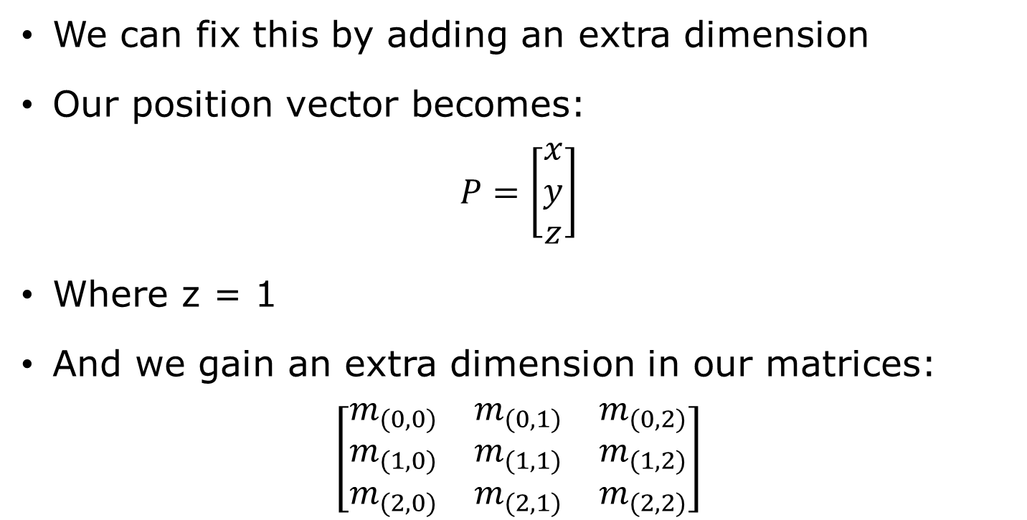
Homogeneous Coordinates
We can fix this by adding an extra dimension
Our position vector becomes:
$$P=\left[\begin{matrix}x \\ y \\ z\end{matrix}\right]$$
Where z = 1
And we gain an extra dimension in our matrices:
$$\left[\begin{matrix}m_{(0,0)} & m_{(0,1)} & m_{(0,2)} \\ m_{(1,0)} & m_{(1,1)} & m_{(1,2)} \\ m_{(2,0)} & m_{(2,1)} & m_{(2,2)}\end{matrix}\right]$$

Slide 18
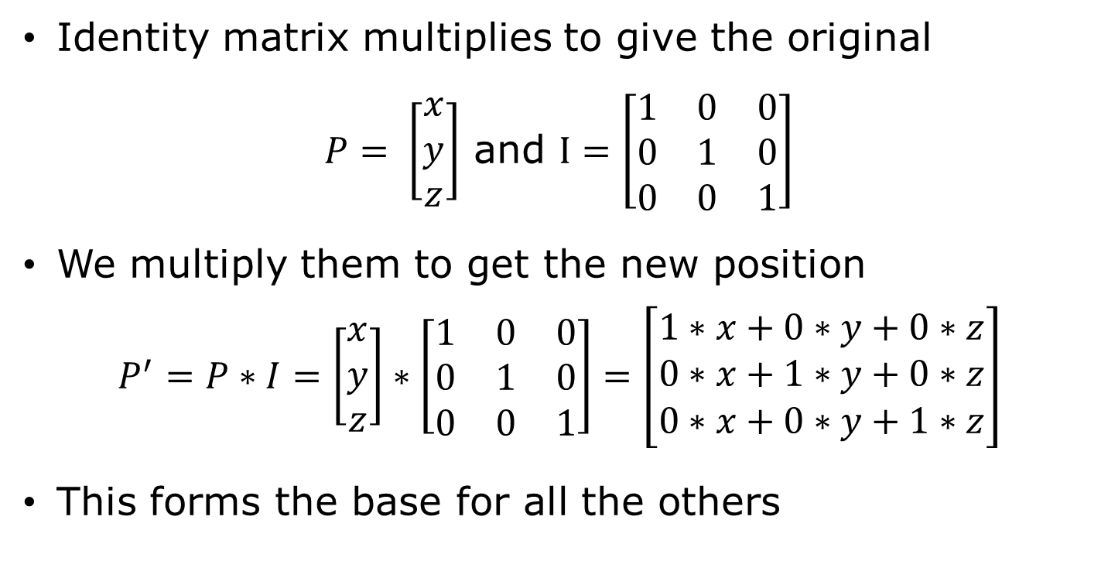
Identity matrix
Identity matrix multiplies to give the original
$P= \left[\begin{matrix}x \\ y \\ z\end{matrix}\right]$ and $I=\left[\begin{matrix}1 & 0 & 0 \\ 0 & 1 & 0 \\ 0 & 0 & 1\end{matrix}\right]$
We multiply them to get the new position
$$P^{′}=P∗I=\left[\begin{matrix}x \\ y \\ z\end{matrix}\right]∗\left[\begin{matrix}1 & 0 & 0 \\ 0 & 1 & 0 \\ 0 & 0 & 1\end{matrix}\right]=\left[\begin{matrix}1∗x+0∗y+0∗z \\ 0∗x+1∗y+0∗z \\ 0∗x+0∗y+1∗z\end{matrix}\right]$$
This forms the base for all the others

Slide 19

Identity
We multiply them to get the new position
$$P^{′}=I∗P=\left[\begin{matrix}1 & 0 & 0 \\ 0 & 1 & 0 \\ 0 & 0 & 1\end{matrix}\right]∗\left[\begin{matrix}x \\ y \\ z\end{matrix}\right]$$

Slide 20

Identity
$$\left[\begin{matrix}1 & 0 & 0 \\ 0 & 1 & 0 \\ 0 & 0 & 1\end{matrix}\right]∗\left[\begin{matrix}x \\ y \\ z\end{matrix}\right]=\left[\begin{matrix}x′ \\ y′ \\ z′\end{matrix}\right]$$
$x^{′}=\left[\begin{matrix}1 \\ 0 \\ 0\end{matrix}\right]∗\left[\begin{matrix}x \\ y \\ z\end{matrix}\right]=\left[\begin{matrix}1∗x \\ 0∗y \\ 0∗z\end{matrix}\right]=\left[1∗x+0∗y+0∗z\right]$

Slide 21

Identity
$$\left[\begin{matrix}1 & 0 & 0 \\ 0 & 1 & 0 \\ 0 & 0 & 1\end{matrix}\right]∗\left[\begin{matrix}x \\ y \\ z\end{matrix}\right]=\left[\begin{matrix}x′ \\ y′ \\ z′\end{matrix}\right]$$
$y^{′}=\left[\begin{matrix}0 \\ 1 \\ 0\end{matrix}\right]∗\left[\begin{matrix}x \\ y \\ z\end{matrix}\right]=\left[\begin{matrix}0∗x \\ 1∗y \\ 0∗z\end{matrix}\right]=\left[0∗x+1∗y+0∗z\right]$

Slide 22

Identity
$$\left[\begin{matrix}1 & 0 & 0 \\ 0 & 1 & 0 \\ 0 & 0 & 1\end{matrix}\right]∗\left[\begin{matrix}x \\ y \\ z\end{matrix}\right]=\left[\begin{matrix}x′ \\ y′ \\ z′\end{matrix}\right]$$
$z^{′}=\left[\begin{matrix}0 \\ 0 \\ 1\end{matrix}\right]∗\left[\begin{matrix}x \\ y \\ z\end{matrix}\right]=\left[\begin{matrix}0∗x \\ 0∗y \\ 1∗z\end{matrix}\right]=\left[0∗x+0∗y+1∗z\right]$

Slide 23
Class exercise
www.menti.com
48 60 05

Slide 24
Take a break!
We have done a bit of matrix maths
Woo!
Go team.

Slide 25
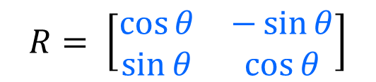

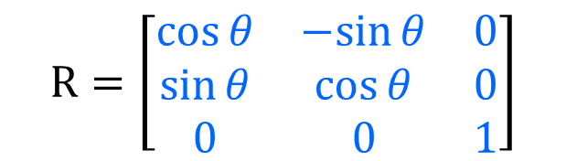
So we know that we can rotate
Lets start with a position vector P and a rotation matrix R
$$P= \left[\begin{matrix}x \\ y \\ z\end{matrix}\right]$$
$$R=\left[\begin{matrix}\cos{θ} & −sin{θ} & 0 \\ \sin{θ} & \cos{θ} & 0 \\ 0 & 0 & 1\end{matrix}\right]$$
$$R= \left[\begin{matrix}\cos{θ} & −\sin{θ} \\ \sin{θ} & \cos{θ}\end{matrix}\right]$$

Slide 26

rotation
We multiply them to get the new position
$$P^{′}=R∗P=\left[\begin{matrix}\cos{θ} & −sin{θ} & 0 \\ \sin{θ} & \cos{θ} & 0 \\ 0 & 0 & 1\end{matrix}\right]∗\left[\begin{matrix}x \\ y \\ z\end{matrix}\right]$$

Slide 27
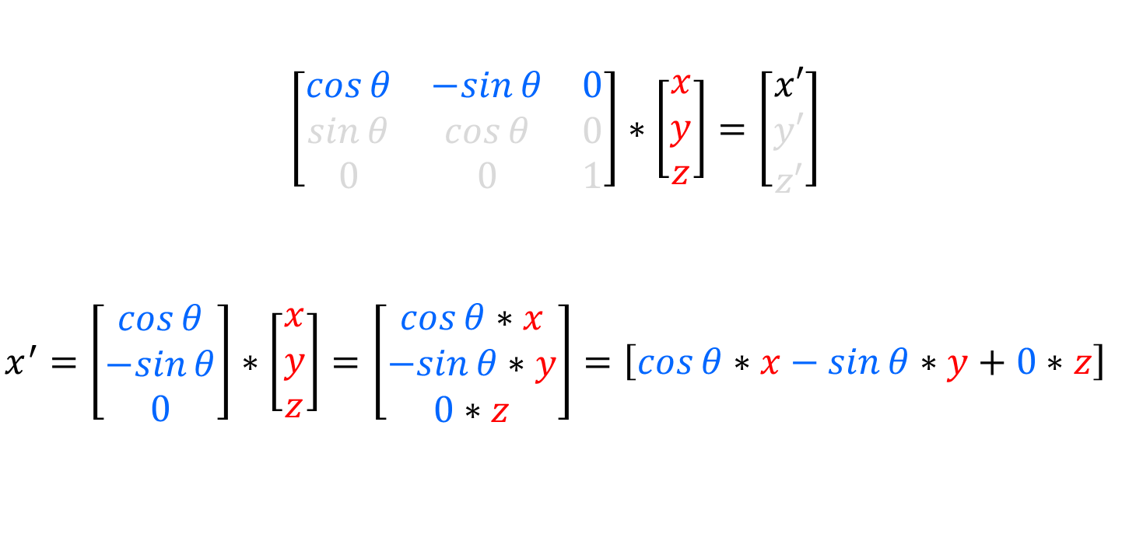
rotation
$$\left[\begin{matrix}cos⁡θ & −sin⁡θ & 0 \\ sin⁡θ & cos⁡θ & 0 \\ 0 & 0 & 1\end{matrix}\right]∗\left[\begin{matrix}x \\ y \\ z\end{matrix}\right]=\left[\begin{matrix}x′ \\ y′ \\ z′\end{matrix}\right]$$
$x^{′}=\left[\begin{matrix}cos⁡θ \\ −sin⁡θ \\ 0\end{matrix}\right]∗\left[\begin{matrix}x \\ y \\ z\end{matrix}\right]=\left[\begin{matrix}cos⁡θ∗x \\ −sin⁡θ∗y \\ 0∗z\end{matrix}\right]=\left[cos⁡θ∗x−sin⁡θ∗y+0∗z\right]$

Slide 28
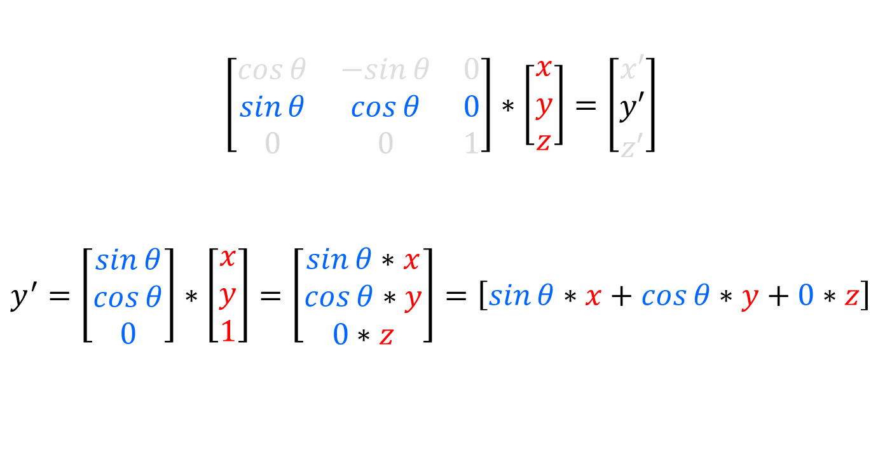
rotation
$$\left[\begin{matrix}cos⁡θ & −sin⁡θ & 0 \\ sin⁡θ & cos⁡θ & 0 \\ 0 & 0 & 1\end{matrix}\right]∗\left[\begin{matrix}x \\ y \\ z\end{matrix}\right]=\left[\begin{matrix}x′ \\ y′ \\ z′\end{matrix}\right]$$
$y^{′}=\left[\begin{matrix}sin⁡θ \\ cos⁡θ \\ 0\end{matrix}\right]∗\left[\begin{matrix}x \\ y \\ 1\end{matrix}\right]=\left[\begin{matrix}sin⁡θ∗x \\ cos⁡θ∗y \\ 0∗z\end{matrix}\right]=\left[sin⁡θ∗x+cos⁡θ∗y+0∗z\right]$

Slide 29

rotation
$$\left[\begin{matrix}cos⁡θ & −sin⁡θ & dx \\ sin⁡θ & cos⁡θ & dy \\ 0 & 0 & 1\end{matrix}\right]∗\left[\begin{matrix}x \\ y \\ z\end{matrix}\right]=\left[\begin{matrix}x′ \\ y′ \\ z′\end{matrix}\right]$$
$z^{′}=\left[\begin{matrix}0 \\ 0 \\ 1\end{matrix}\right]∗\left[\begin{matrix}x \\ y \\ z\end{matrix}\right]=\left[\begin{matrix}0∗x \\ 0∗y \\ 1∗1\end{matrix}\right]=\left[0∗x+0∗y+1∗z\right]$

Slide 30
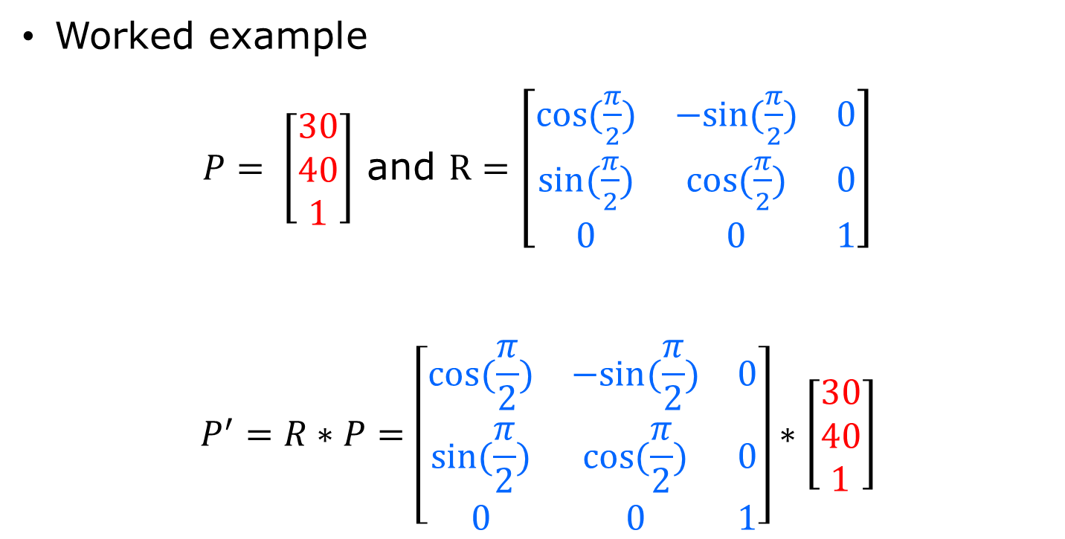
rotation
Worked example
$P= \left[\begin{matrix}30 \\ 40 \\ 1\end{matrix}\right]$ and $R=\left[\begin{matrix}cos⁡(\frac{π}{2}) & −sin⁡(\frac{π}{2}) & 0 \\ sin⁡(\frac{π}{2}) & cos⁡(\frac{π}{2}) & 0 \\ 0 & 0 & 1\end{matrix}\right]$
$$P^{′}=R∗P=\left[\begin{matrix}cos⁡(\frac{π}{2}) & −sin⁡(\frac{π}{2}) & 0 \\ sin⁡(\frac{π}{2}) & cos⁡(\frac{π}{2}) & 0 \\ 0 & 0 & 1\end{matrix}\right]∗\left[\begin{matrix}30 \\ 40 \\ 1\end{matrix}\right]$$

Slide 31
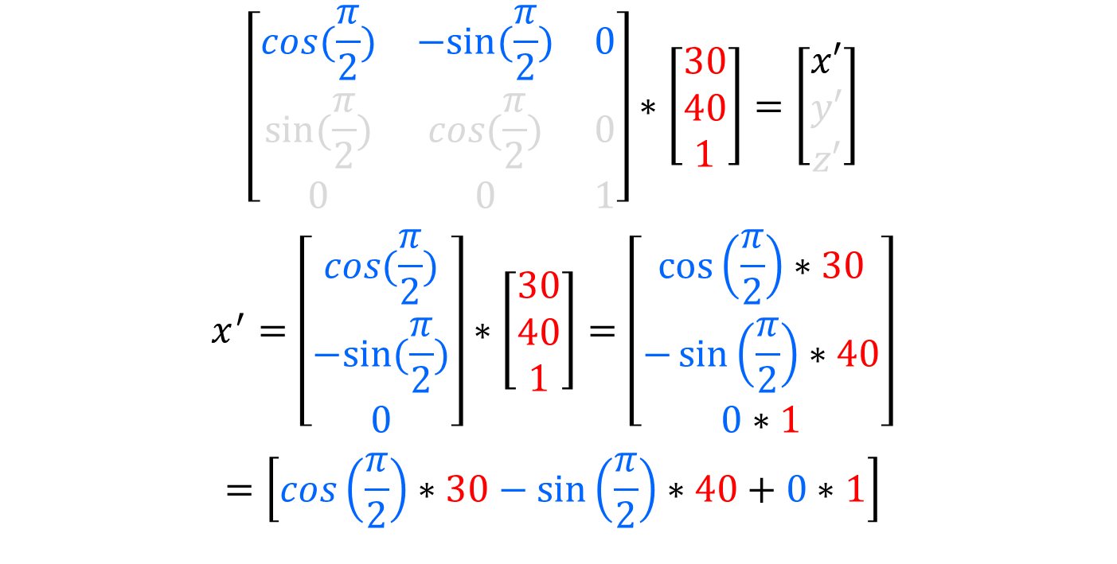
rotation
$$\left[\begin{matrix}cos⁡(\frac{π}{2}) & −sin⁡(\frac{π}{2}) & 0 \\ sin⁡(\frac{π}{2}) & cos⁡(\frac{π}{2}) & 0 \\ 0 & 0 & 1\end{matrix}\right]∗\left[\begin{matrix}30 \\ 40 \\ 1\end{matrix}\right]=\left[\begin{matrix}x′ \\ y′ \\ z′\end{matrix}\right]$$
$$x^{′}=\left[\begin{matrix}cos⁡(\frac{π}{2}) \\ −sin⁡(\frac{π}{2}) \\ 0\end{matrix}\right]∗\left[\begin{matrix}30 \\ 40 \\ 1\end{matrix}\right]=\left[\begin{matrix}\cos\left(\frac{π}{2}\right)∗30 \\ −\sin\left(\frac{π}{2}\right)∗40 \\ 0∗1\end{matrix}\right]$$
$$=\left[\cos\left(\frac{π}{2}\right)∗30−\sin\left(\frac{π}{2}\right)∗40+0∗1\right]$$

Slide 32

rotation
$$=\left[0∗30−1∗40+0∗1\right]$$
$$=\left[0−40+0\right]$$
$\left[\begin{matrix}x′ \\ y′ \\ z′\end{matrix}\right]=−$40

Slide 33
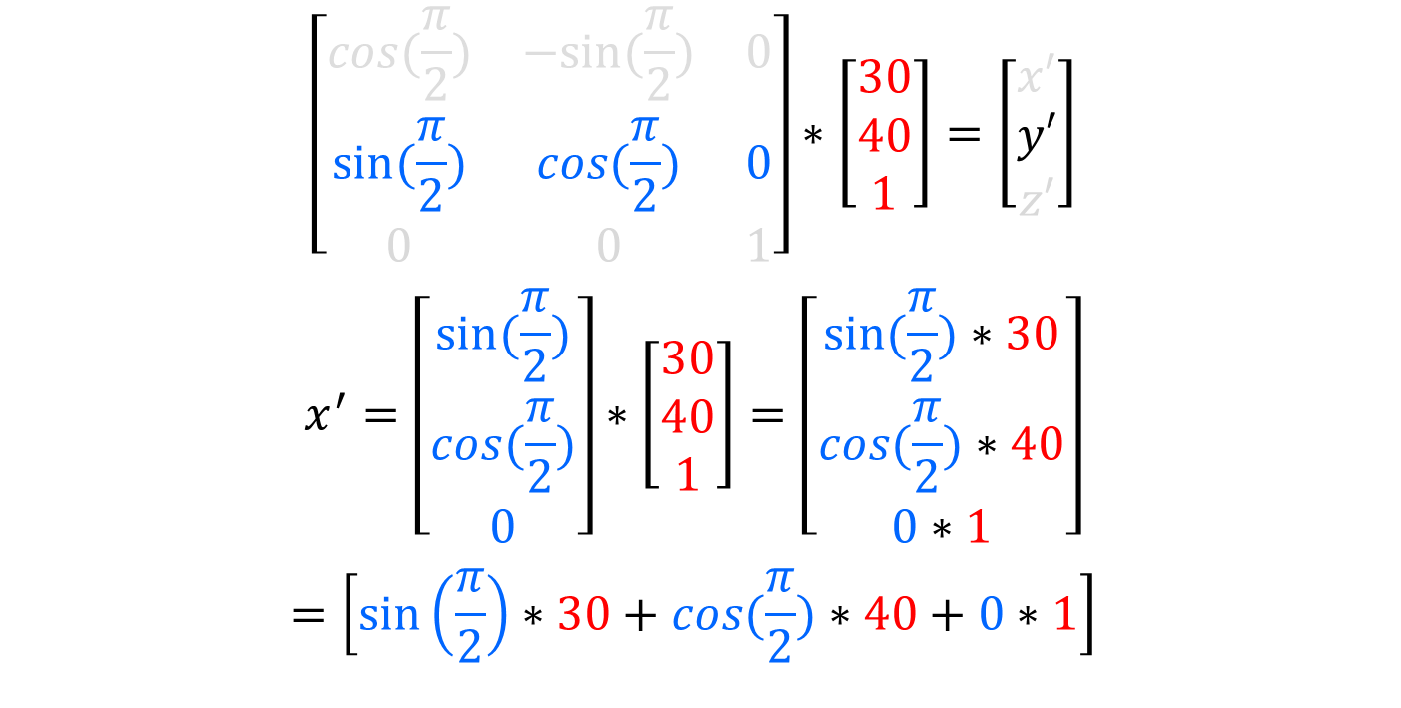
rotation
$$\left[\begin{matrix}cos⁡(\frac{π}{2}) & −sin⁡(\frac{π}{2}) & 0 \\ sin⁡(\frac{π}{2}) & cos⁡(\frac{π}{2}) & 0 \\ 0 & 0 & 1\end{matrix}\right]∗\left[\begin{matrix}30 \\ 40 \\ 1\end{matrix}\right]=\left[\begin{matrix}x′ \\ y′ \\ z′\end{matrix}\right]$$
$$x^{′}=\left[\begin{matrix}sin⁡(\frac{π}{2}) \\ cos⁡(\frac{π}{2}) \\ 0\end{matrix}\right]∗\left[\begin{matrix}30 \\ 40 \\ 1\end{matrix}\right]=\left[\begin{matrix}sin⁡(\frac{π}{2})∗30 \\ cos⁡(\frac{π}{2})∗40 \\ 0∗1\end{matrix}\right]$$
$$=\left[\sin\left(\frac{π}{2}\right)∗30+cos⁡(\frac{π}{2})∗40+0∗1\right]$$

Slide 34

rotation
$$=\left[1∗30+0∗40+0∗1\right]$$
$$=\left[30+0+0\right]$$
$$\left[\begin{matrix}x′ \\ y′ \\ z′\end{matrix}\right]=30$$

Slide 35
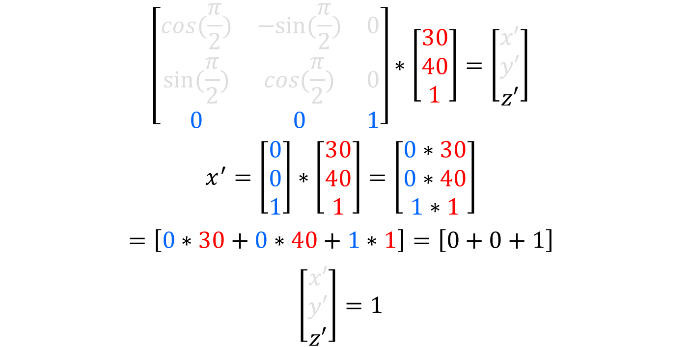
rotation
$$\left[\begin{matrix}cos⁡(\frac{π}{2}) & −sin⁡(\frac{π}{2}) & 0 \\ sin⁡(\frac{π}{2}) & cos⁡(\frac{π}{2}) & 0 \\ 0 & 0 & 1\end{matrix}\right]∗\left[\begin{matrix}30 \\ 40 \\ 1\end{matrix}\right]=\left[\begin{matrix}x′ \\ y′ \\ z′\end{matrix}\right]$$
$$x^{′}=\left[\begin{matrix}0 \\ 0 \\ 1\end{matrix}\right]∗\left[\begin{matrix}30 \\ 40 \\ 1\end{matrix}\right]=\left[\begin{matrix}0∗30 \\ 0∗40 \\ 1∗1\end{matrix}\right]$$
$$=\left[0∗30+0∗40+1∗1\right]=\left[0+0+1\right]$$
$$\left[\begin{matrix}x′ \\ y′ \\ z′\end{matrix}\right]=1$$

Slide 36

rotation
Result
$P= \left[\begin{matrix}30 \\ 40 \\ 1\end{matrix}\right]$ and $R=\left[\begin{matrix}cos⁡(\frac{π}{2}) & −sin⁡(\frac{π}{2}) & 0 \\ sin⁡(\frac{π}{2}) & cos⁡(\frac{π}{2}) & 0 \\ 0 & 0 & 1\end{matrix}\right]$
$$P^{′}=\left[\begin{matrix}x^{′} \\ y^{′} \\ z^{′}\end{matrix}\right]=\left[\begin{matrix}−40 \\ 30 \\ 1\end{matrix}\right]$$

Slide 37

rotation
P’ (-40, 30)
P (30, 40)

Slide 38
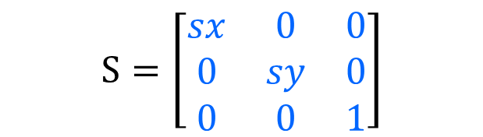


And we know that we can scale
Lets start with a position vector P and a rotation matrix S
$$P= \left[\begin{matrix}x \\ y \\ z\end{matrix}\right]$$
$$S= \left[\begin{matrix}sx & 0 \\ 0 & sy\end{matrix}\right]$$
$$S=\left[\begin{matrix}sx & 0 & 0 \\ 0 & sy & 0 \\ 0 & 0 & 1\end{matrix}\right]$$

Slide 39

scale
We multiply them to get the new position
$$P^{′}=S∗P=\left[\begin{matrix}s_{x} & 0 & 0 \\ 0 & s_{y} & 0 \\ 0 & 0 & 1\end{matrix}\right]∗\left[\begin{matrix}x \\ y \\ z\end{matrix}\right]$$

Slide 40

scale
$$\left[\begin{matrix}s_{x} & 0 & 0 \\ 0 & s_{y} & 0 \\ 0 & 0 & 1\end{matrix}\right]∗\left[\begin{matrix}x \\ y \\ z\end{matrix}\right]=\left[\begin{matrix}x′ \\ y′ \\ z′\end{matrix}\right]$$
$x^{′}=\left[\begin{matrix}s_{x} \\ 0 \\ 0\end{matrix}\right]∗\left[\begin{matrix}x \\ y \\ z\end{matrix}\right]=\left[\begin{matrix}s_{x}∗x \\ 0∗y \\ 0∗z\end{matrix}\right]=\left[s_{x}∗x+0∗y+0∗z\right]$

Slide 41

scale
$$\left[\begin{matrix}s_{x} & 0 & 0 \\ 0 & s_{y} & 0 \\ 0 & 0 & 1\end{matrix}\right]∗\left[\begin{matrix}x \\ y \\ z\end{matrix}\right]=\left[\begin{matrix}x′ \\ y′ \\ z′\end{matrix}\right]$$
$y^{′}=\left[\begin{matrix}0 \\ s_{y} \\ 0\end{matrix}\right]∗\left[\begin{matrix}x \\ y \\ 1\end{matrix}\right]=\left[\begin{matrix}0∗x \\ s_{y}∗y \\ 0∗z\end{matrix}\right]=\left[0∗x+s_{y}∗y+0∗z\right]$

Slide 42

scale
$$\left[\begin{matrix}sx & 0 & 0 \\ 0 & sy & 0 \\ 0 & 0 & 1\end{matrix}\right]∗\left[\begin{matrix}x \\ y \\ z\end{matrix}\right]=\left[\begin{matrix}x′ \\ y′ \\ z′\end{matrix}\right]$$
$z^{′}=\left[\begin{matrix}0 \\ 0 \\ 1\end{matrix}\right]∗\left[\begin{matrix}x \\ y \\ z\end{matrix}\right]=\left[\begin{matrix}0∗x \\ 0∗y \\ 1∗1\end{matrix}\right]=\left[0∗x+0∗y+1∗z\right]$

Slide 43

scale
Worked example
$P= \left[\begin{matrix}30 \\ 40 \\ 1\end{matrix}\right]$ and $S=\left[\begin{matrix}2 & 0 & 0 \\ 0 & 2 & 0 \\ 0 & 0 & 1\end{matrix}\right]$
$$P^{′}=S∗P=\left[\begin{matrix}2 & 0 & 0 \\ 0 & 2 & 0 \\ 0 & 0 & 1\end{matrix}\right]∗\left[\begin{matrix}30 \\ 40 \\ 1\end{matrix}\right]$$

Slide 44
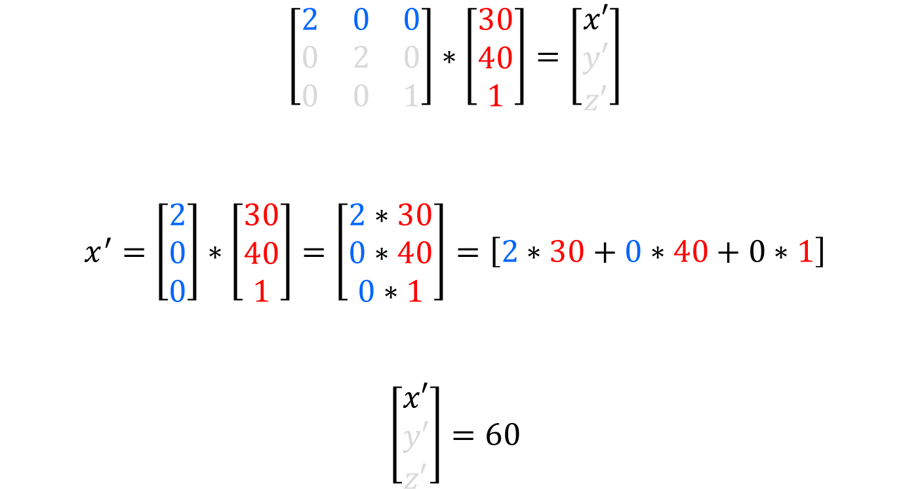
scale
$$\left[\begin{matrix}2 & 0 & 0 \\ 0 & 2 & 0 \\ 0 & 0 & 1\end{matrix}\right]∗\left[\begin{matrix}30 \\ 40 \\ 1\end{matrix}\right]=\left[\begin{matrix}x′ \\ y′ \\ z′\end{matrix}\right]$$
$x^{′}=\left[\begin{matrix}2 \\ 0 \\ 0\end{matrix}\right]∗\left[\begin{matrix}30 \\ 40 \\ 1\end{matrix}\right]=\left[\begin{matrix}2∗30 \\ 0∗40 \\ 0∗1\end{matrix}\right]=\left[2∗30+0∗40+0∗1\right]$
$$\left[\begin{matrix}x′ \\ y′ \\ z′\end{matrix}\right]=60$$

Slide 45
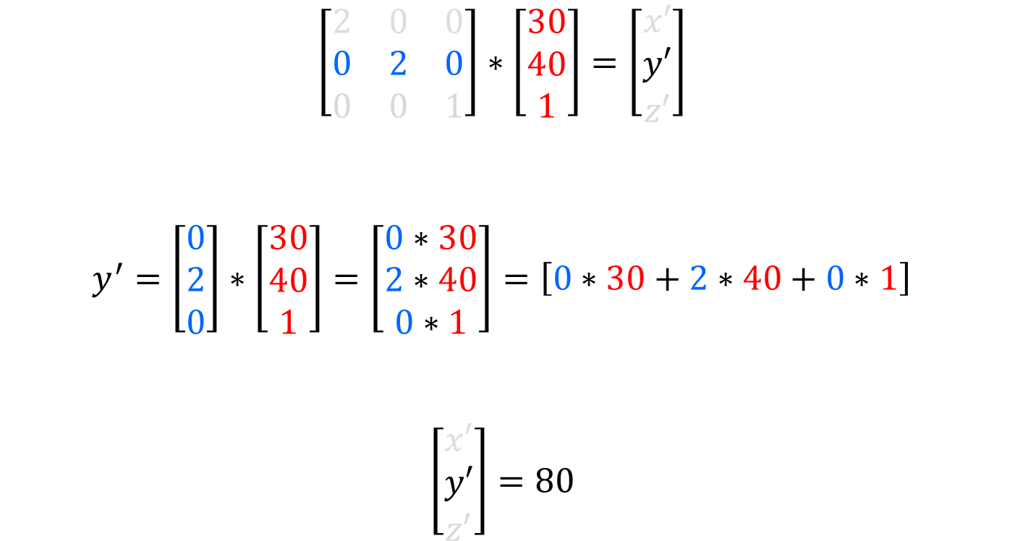
scale
$$\left[\begin{matrix}2 & 0 & 0 \\ 0 & 2 & 0 \\ 0 & 0 & 1\end{matrix}\right]∗\left[\begin{matrix}30 \\ 40 \\ 1\end{matrix}\right]=\left[\begin{matrix}x′ \\ y′ \\ z′\end{matrix}\right]$$
$y^{′}=\left[\begin{matrix}0 \\ 2 \\ 0\end{matrix}\right]∗\left[\begin{matrix}30 \\ 40 \\ 1\end{matrix}\right]=\left[\begin{matrix}0∗30 \\ 2∗40 \\ 0∗1\end{matrix}\right]=\left[0∗30+2∗40+0∗1\right]$
$$\left[\begin{matrix}x′ \\ y′ \\ z′\end{matrix}\right]=80$$

Slide 46
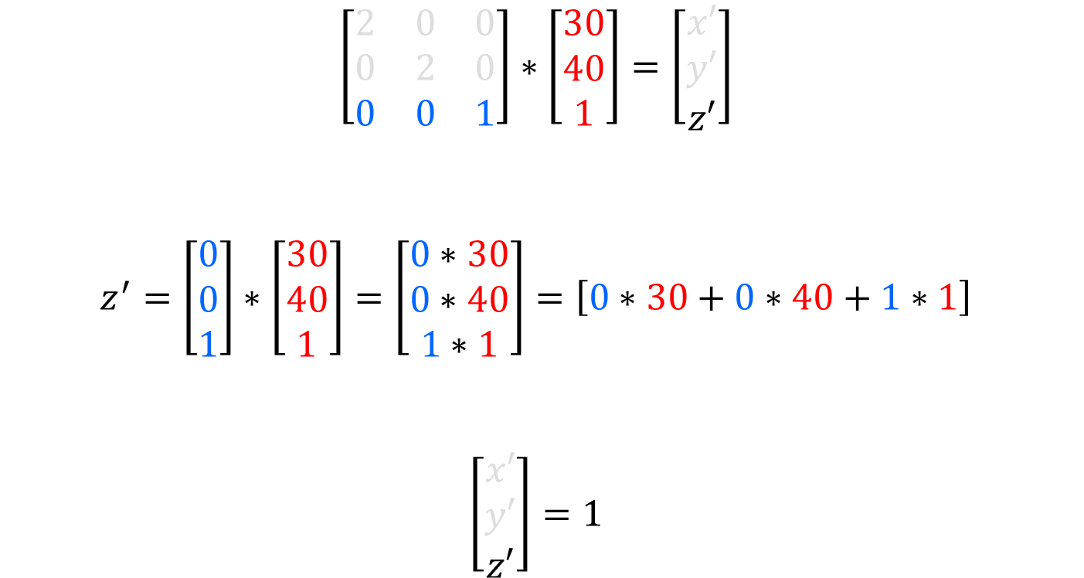
scale
$$\left[\begin{matrix}2 & 0 & 0 \\ 0 & 2 & 0 \\ 0 & 0 & 1\end{matrix}\right]∗\left[\begin{matrix}30 \\ 40 \\ 1\end{matrix}\right]=\left[\begin{matrix}x′ \\ y′ \\ z′\end{matrix}\right]$$
$z^{′}=\left[\begin{matrix}0 \\ 0 \\ 1\end{matrix}\right]∗\left[\begin{matrix}30 \\ 40 \\ 1\end{matrix}\right]=\left[\begin{matrix}0∗30 \\ 0∗40 \\ 1∗1\end{matrix}\right]=\left[0∗30+0∗40+1∗1\right]$
$$\left[\begin{matrix}x′ \\ y′ \\ z′\end{matrix}\right]=1$$

Slide 47

scale
Result
$P= \left[\begin{matrix}30 \\ 40 \\ 1\end{matrix}\right]$ and $S=\left[\begin{matrix}2 & 0 & 0 \\ 0 & 2 & 0 \\ 0 & 0 & 1\end{matrix}\right]$
$$P^{′}=\left[\begin{matrix}x^{′} \\ y^{′} \\ z^{′}\end{matrix}\right]=\left[\begin{matrix}60 \\ 80 \\ 1\end{matrix}\right]$$

Slide 48
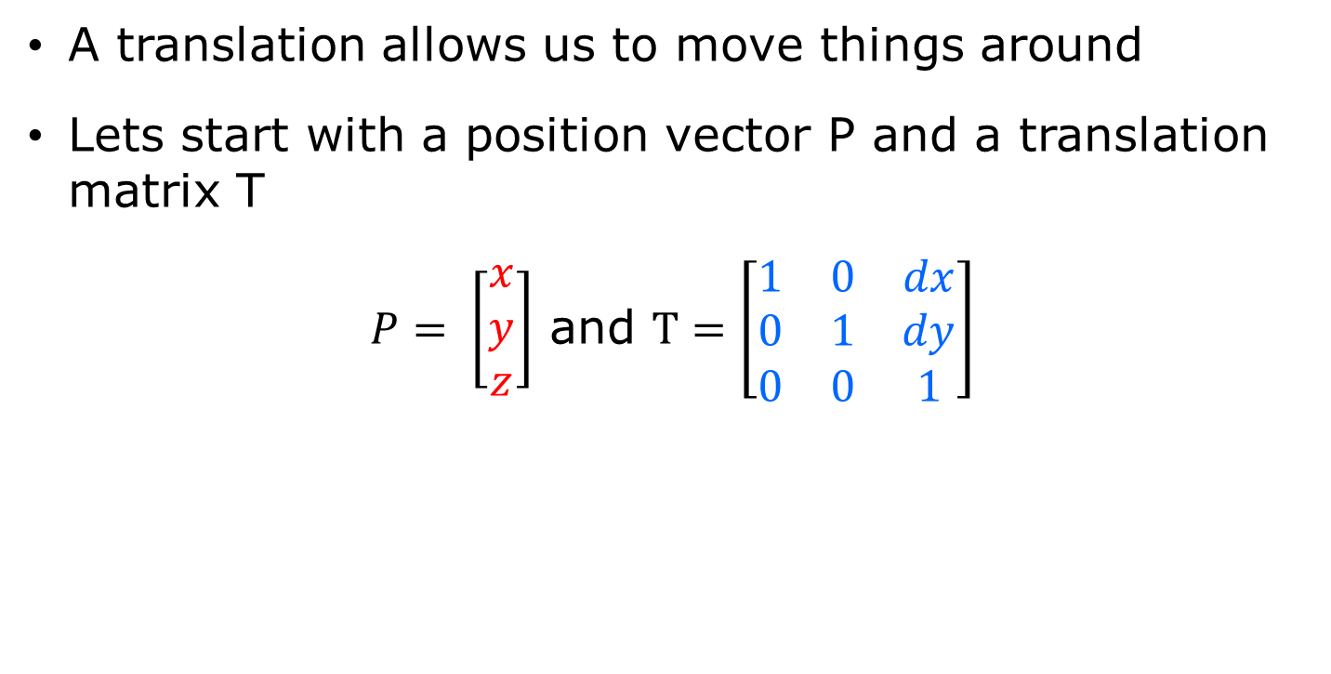
Now we can translate
A translation allows us to move things around
Lets start with a position vector P and a translation matrix T
$P= \left[\begin{matrix}x \\ y \\ z\end{matrix}\right]$ and $T=\left[\begin{matrix}1 & 0 & dx \\ 0 & 1 & dy \\ 0 & 0 & 1\end{matrix}\right]$

Slide 49

translation
We multiply them to get the new position
$$P^{′}=T∗P=\left[\begin{matrix}1 & 0 & dx \\ 0 & 1 & dy \\ 0 & 0 & 1\end{matrix}\right]∗\left[\begin{matrix}x \\ y \\ z\end{matrix}\right]$$

Slide 50

translation
$$\left[\begin{matrix}1 & 0 & dx \\ 0 & 1 & dy \\ 0 & 0 & 1\end{matrix}\right]∗\left[\begin{matrix}x \\ y \\ z\end{matrix}\right]=\left[\begin{matrix}x′ \\ y′ \\ z′\end{matrix}\right]$$
$x^{′}=\left[\begin{matrix}1 \\ 0 \\ dx\end{matrix}\right]∗\left[\begin{matrix}x \\ y \\ z\end{matrix}\right]=\left[\begin{matrix}1∗x \\ 0∗y \\ dx∗z\end{matrix}\right]=\left[1∗x+0∗y+dx∗z\right]$

Slide 51

translation
$$\left[\begin{matrix}1 & 0 & dx \\ 0 & 1 & dy \\ 0 & 0 & 1\end{matrix}\right]∗\left[\begin{matrix}x \\ y \\ z\end{matrix}\right]=\left[\begin{matrix}x′ \\ y′ \\ z′\end{matrix}\right]$$
$y^{′}=\left[\begin{matrix}0 \\ 1 \\ dy\end{matrix}\right]∗\left[\begin{matrix}x \\ y \\ 1\end{matrix}\right]=\left[\begin{matrix}0∗x \\ 1∗y \\ dy∗z\end{matrix}\right]=\left[0∗x+1∗y+dy∗z\right]$

Slide 52

translation
$$\left[\begin{matrix}1 & 0 & dx \\ 0 & 1 & dy \\ 0 & 0 & 1\end{matrix}\right]∗\left[\begin{matrix}x \\ y \\ z\end{matrix}\right]=\left[\begin{matrix}x′ \\ y′ \\ z′\end{matrix}\right]$$
$z^{′}=\left[\begin{matrix}0 \\ 0 \\ 1\end{matrix}\right]∗\left[\begin{matrix}x \\ y \\ z\end{matrix}\right]=\left[\begin{matrix}0∗x \\ 0∗y \\ 1∗1\end{matrix}\right]=\left[0∗x+0∗y+1∗z\right]$

Slide 53

translation
Worked example
$P= \left[\begin{matrix}30 \\ 40 \\ 1\end{matrix}\right]$ and $T=\left[\begin{matrix}1 & 0 & 200 \\ 0 & 1 & 0 \\ 0 & 0 & 1\end{matrix}\right]$
$$P^{′}=T∗P=\left[\begin{matrix}1 & 0 & 200 \\ 0 & 1 & 0 \\ 0 & 0 & 1\end{matrix}\right]∗\left[\begin{matrix}30 \\ 40 \\ 1\end{matrix}\right]$$

Slide 54
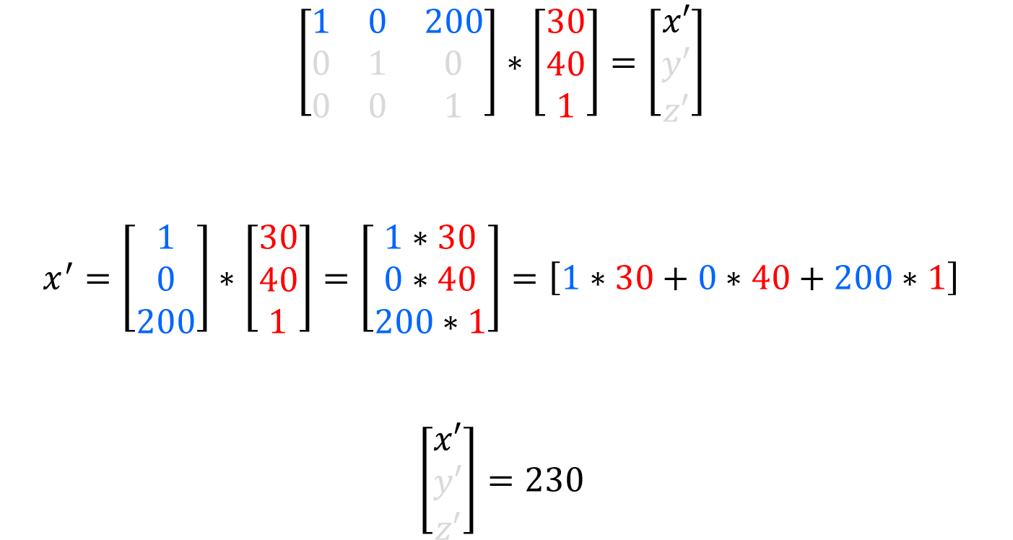
translation
$$\left[\begin{matrix}1 & 0 & 200 \\ 0 & 1 & 0 \\ 0 & 0 & 1\end{matrix}\right]∗\left[\begin{matrix}30 \\ 40 \\ 1\end{matrix}\right]=\left[\begin{matrix}x′ \\ y′ \\ z′\end{matrix}\right]$$
$x^{′}=\left[\begin{matrix}1 \\ 0 \\ 200\end{matrix}\right]∗\left[\begin{matrix}30 \\ 40 \\ 1\end{matrix}\right]=\left[\begin{matrix}1∗30 \\ 0∗40 \\ 200∗1\end{matrix}\right]=\left[1∗30+0∗40+200∗1\right]$
$$\left[\begin{matrix}x′ \\ y′ \\ z′\end{matrix}\right]=230$$

Slide 55
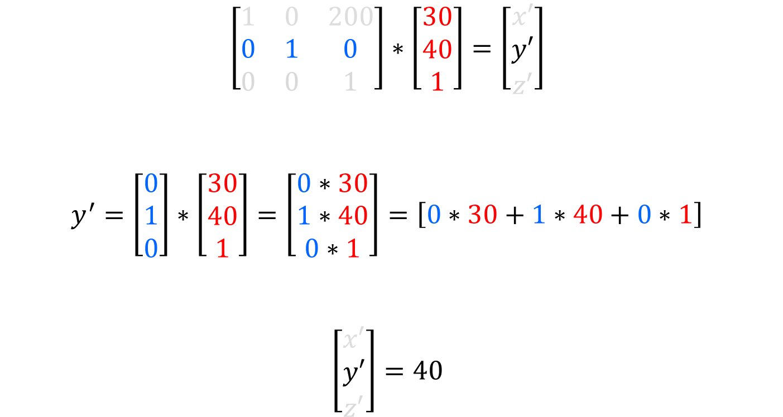
translation
$$\left[\begin{matrix}1 & 0 & 200 \\ 0 & 1 & 0 \\ 0 & 0 & 1\end{matrix}\right]∗\left[\begin{matrix}30 \\ 40 \\ 1\end{matrix}\right]=\left[\begin{matrix}x′ \\ y′ \\ z′\end{matrix}\right]$$
$y^{′}=\left[\begin{matrix}0 \\ 1 \\ 0\end{matrix}\right]∗\left[\begin{matrix}30 \\ 40 \\ 1\end{matrix}\right]=\left[\begin{matrix}0∗30 \\ 1∗40 \\ 0∗1\end{matrix}\right]=\left[0∗30+1∗40+0∗1\right]$
$$\left[\begin{matrix}x′ \\ y′ \\ z′\end{matrix}\right]=40$$

Slide 56
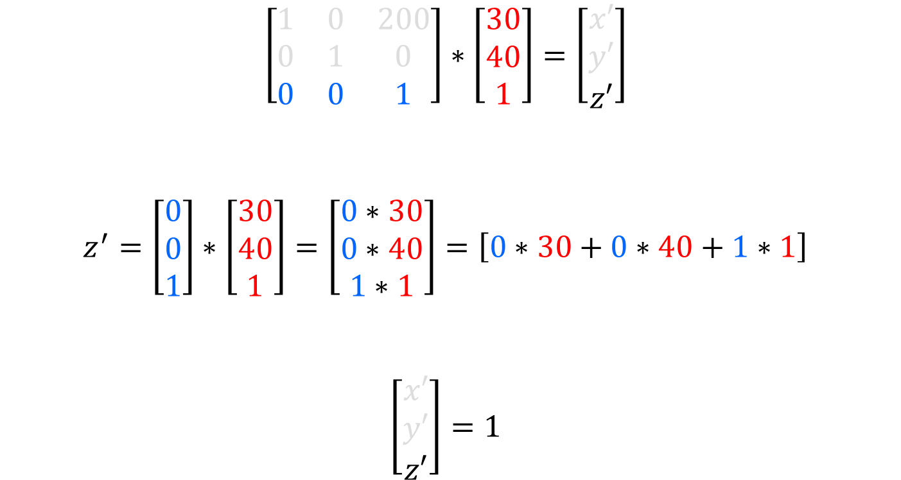
translation
$$\left[\begin{matrix}1 & 0 & 200 \\ 0 & 1 & 0 \\ 0 & 0 & 1\end{matrix}\right]∗\left[\begin{matrix}30 \\ 40 \\ 1\end{matrix}\right]=\left[\begin{matrix}x′ \\ y′ \\ z′\end{matrix}\right]$$
$z^{′}=\left[\begin{matrix}0 \\ 0 \\ 1\end{matrix}\right]∗\left[\begin{matrix}30 \\ 40 \\ 1\end{matrix}\right]=\left[\begin{matrix}0∗30 \\ 0∗40 \\ 1∗1\end{matrix}\right]=\left[0∗30+0∗40+1∗1\right]$
$$\left[\begin{matrix}x′ \\ y′ \\ z′\end{matrix}\right]=1$$

Slide 57

translation
Result
$P= \left[\begin{matrix}30 \\ 40 \\ 1\end{matrix}\right]$ and $T=\left[\begin{matrix}1 & 0 & 200 \\ 0 & 1 & 0 \\ 0 & 0 & 1\end{matrix}\right]$
$$P^{′}=\left[\begin{matrix}x^{′} \\ y^{′} \\ z^{′}\end{matrix}\right]=\left[\begin{matrix}230 \\ 40 \\ 1\end{matrix}\right]$$

Slide 58

Combining Matrices
$M1=\left[\begin{matrix}m_{(0,0)} & m_{(0,1)} & m_{(0,2)} \\ m_{(1,0)} & m_{(1,1)} & m_{(1,2)} \\ m_{(2,0)} & m_{(2,1)} & m_{(2,2)}\end{matrix}\right]$and $M2=\left[\begin{matrix}m_{(0,0)} & m_{(0,1)} & m_{(0,2)} \\ m_{(1,0)} & m_{(1,1)} & m_{(1,2)} \\ m_{(2,0)} & m_{(2,1)} & m_{(2,2)}\end{matrix}\right]$
$$M3=M1∗M2$$
$$=\left[\begin{matrix}m_{(0,0)} & m_{(0,1)} & m_{(0,2)} \\ m_{(1,0)} & m_{(1,1)} & m_{(1,2)} \\ m_{(2,0)} & m_{(2,1)} & m_{(2,2)}\end{matrix}\right]∗\left[\begin{matrix}m_{(0,0)} & m_{(0,1)} & m_{(0,2)} \\ m_{(1,0)} & m_{(1,1)} & m_{(1,2)} \\ m_{(2,0)} & m_{(2,1)} & m_{(2,2)}\end{matrix}\right]$$

Slide 59

Combining Matrices
$$\left[\begin{matrix}m_{(0,0)} & m_{(0,1)} & m_{(0,2)} \\ m_{(1,0)} & m_{(1,1)} & m_{(1,2)} \\ m_{(2,0)} & m_{(2,1)} & m_{(2,2)}\end{matrix}\right]$$
$$=\left[\begin{matrix}m_{(0,0)} & m_{(0,1)} & m_{(0,2)} \\ m_{(1,0)} & m_{(1,1)} & m_{(1,2)} \\ m_{(2,0)} & m_{(2,1)} & m_{(2,2)}\end{matrix}\right]∗\left[\begin{matrix}m_{(0,0)} & m_{(0,1)} & m_{(0,2)} \\ m_{(1,0)} & m_{(1,1)} & m_{(1,2)} \\ m_{(2,0)} & m_{(2,1)} & m_{(2,2)}\end{matrix}\right]$$
$${m_{(0,0)}}^{′}=\left[\begin{matrix}m_{(0,0)} \\ m_{(0,1)} \\ m_{(0,2)}\end{matrix}\right]∗\left[\begin{matrix}m_{\left(0,0\right)} \\ m_{\left(1,0\right)} \\ m_{\left(2,0\right)}\end{matrix}\right]=\left[\begin{matrix}m_{\left(0,0\right)}∗m_{\left(0,0\right)} \\ m_{\left(0,1\right)}∗m_{\left(1,0\right)} \\ m_{\left(0,2\right)}∗m_{\left(2,0\right)}\end{matrix}\right]$$
$$=\left[m_{(0,0)}∗m_{(0,0)}+m_{(0,1)}∗m_{(1,0)}+m_{(0,2)}∗m_{(2,0)}\right]$$

Slide 60

Combining Matrices
$$\left[\begin{matrix}m_{(0,0)} & m_{(0,1)} & m_{(0,2)} \\ m_{(1,0)} & m_{(1,1)} & m_{(1,2)} \\ m_{(2,0)} & m_{(2,1)} & m_{(2,2)}\end{matrix}\right]$$
$$=\left[\begin{matrix}m_{(0,0)} & m_{(0,1)} & m_{(0,2)} \\ m_{(1,0)} & m_{(1,1)} & m_{(1,2)} \\ m_{(2,0)} & m_{(2,1)} & m_{(2,2)}\end{matrix}\right]∗\left[\begin{matrix}m_{(0,0)} & m_{(0,1)} & m_{(0,2)} \\ m_{(1,0)} & m_{(1,1)} & m_{(1,2)} \\ m_{(2,0)} & m_{(2,1)} & m_{(2,2)}\end{matrix}\right]$$
$${m_{(0,1)}}^{′}=\left[\begin{matrix}m_{(0,0)} \\ m_{(0,1)} \\ m_{(0,2)}\end{matrix}\right]∗\left[\begin{matrix}m_{\left(0,1\right)} \\ m_{\left(1,1\right)} \\ m_{\left(2,1\right)}\end{matrix}\right]=\left[\begin{matrix}m_{\left(0,0\right)}∗m_{\left(0,1\right)} \\ m_{\left(0,1\right)}∗m_{\left(1,1\right)} \\ m_{\left(0,2\right)}∗m_{\left(2,1\right)}\end{matrix}\right]$$
$$=\left[m_{(0,0)}∗m_{(0,1)}+m_{(0,1)}∗m_{(1,1)}+m_{(0,2)}∗m_{(2,1)}\right]$$

Slide 61

Combining Matrices
$$\left[\begin{matrix}m_{(0,0)} & m_{(0,1)} & m_{(0,2)} \\ m_{(1,0)} & m_{(1,1)} & m_{(1,2)} \\ m_{(2,0)} & m_{(2,1)} & m_{(2,2)}\end{matrix}\right]$$
$$=\left[\begin{matrix}m_{(0,0)} & m_{(0,1)} & m_{(0,2)} \\ m_{(1,0)} & m_{(1,1)} & m_{(1,2)} \\ m_{(2,0)} & m_{(2,1)} & m_{(2,2)}\end{matrix}\right]∗\left[\begin{matrix}m_{(0,0)} & m_{(0,1)} & m_{(0,2)} \\ m_{(1,0)} & m_{(1,1)} & m_{(1,2)} \\ m_{(2,0)} & m_{(2,1)} & m_{(2,2)}\end{matrix}\right]$$
$${m_{(0,2)}}^{′}=\left[\begin{matrix}m_{(0,0)} \\ m_{(0,1)} \\ m_{(0,2)}\end{matrix}\right]∗\left[\begin{matrix}m_{\left(0,2\right)} \\ m_{\left(1,2\right)} \\ m_{\left(2,2\right)}\end{matrix}\right]=\left[\begin{matrix}m_{\left(0,0\right)}∗m_{\left(0,2\right)} \\ m_{\left(0,1\right)}∗m_{\left(1,2\right)} \\ m_{\left(0,2\right)}∗m_{\left(2,2\right)}\end{matrix}\right]$$
$$=\left[m_{(0,0)}∗m_{(0,2)}+m_{(0,1)}∗m_{(1,2)}+m_{(0,2)}∗m_{(2,2)}\right]$$

Slide 62

Combining Matrices
$$\left[\begin{matrix}m_{(0,0)} & m_{(0,1)} & m_{(0,2)} \\ m_{(1,0)} & m_{(1,1)} & m_{(1,2)} \\ m_{(2,0)} & m_{(2,1)} & m_{(2,2)}\end{matrix}\right]$$
$$=\left[\begin{matrix}m_{(0,0)} & m_{(0,1)} & m_{(0,2)} \\ m_{(1,0)} & m_{(1,1)} & m_{(1,2)} \\ m_{(2,0)} & m_{(2,1)} & m_{(2,2)}\end{matrix}\right]∗\left[\begin{matrix}m_{(0,0)} & m_{(0,1)} & m_{(0,2)} \\ m_{(1,0)} & m_{(1,1)} & m_{(1,2)} \\ m_{(2,0)} & m_{(2,1)} & m_{(2,2)}\end{matrix}\right]$$
$${m_{(1,0)}}^{′}=\left[\begin{matrix}m_{(1,0)} \\ m_{(1,1)} \\ m_{(1,2)}\end{matrix}\right]∗\left[\begin{matrix}m_{\left(0,0\right)} \\ m_{\left(1,0\right)} \\ m_{\left(2,0\right)}\end{matrix}\right]=\left[\begin{matrix}m_{\left(1,0\right)}∗m_{\left(0,0\right)} \\ m_{\left(1,1\right)}∗m_{\left(1,0\right)} \\ m_{\left(1,2\right)}∗m_{\left(2,0\right)}\end{matrix}\right]$$
$$=\left[m_{(1,0)}∗m_{(0,0)}+m_{(1,1)}∗m_{(1,0)}+m_{(1,2)}∗m_{(2,0)}\right]$$

Slide 63

Combining Matrices
$$\left[\begin{matrix}m_{(0,0)} & m_{(0,1)} & m_{(0,2)} \\ m_{(1,0)} & m_{(1,1)} & m_{(1,2)} \\ m_{(2,0)} & m_{(2,1)} & m_{(2,2)}\end{matrix}\right]$$
$$=\left[\begin{matrix}m_{(0,0)} & m_{(0,1)} & m_{(0,2)} \\ m_{(1,0)} & m_{(1,1)} & m_{(1,2)} \\ m_{(2,0)} & m_{(2,1)} & m_{(2,2)}\end{matrix}\right]∗\left[\begin{matrix}m_{(0,0)} & m_{(0,1)} & m_{(0,2)} \\ m_{(1,0)} & m_{(1,1)} & m_{(1,2)} \\ m_{(2,0)} & m_{(2,1)} & m_{(2,2)}\end{matrix}\right]$$
$${m_{(1,1)}}^{′}=\left[\begin{matrix}m_{(1,0)} \\ m_{(1,1)} \\ m_{(1,2)}\end{matrix}\right]∗\left[\begin{matrix}m_{\left(0,1\right)} \\ m_{\left(1,1\right)} \\ m_{\left(2,1\right)}\end{matrix}\right]=\left[\begin{matrix}m_{\left(1,0\right)}∗m_{\left(0,1\right)} \\ m_{\left(1,1\right)}∗m_{\left(1,1\right)} \\ m_{\left(1,2\right)}∗m_{\left(2,1\right)}\end{matrix}\right]$$
$$=\left[m_{(1,0)}∗m_{(0,1)}+m_{(1,1)}∗m_{(1,1)}+m_{(1,2)}∗m_{(2,1)}\right]$$

Slide 64

Combining Matrices
$$\left[\begin{matrix}m_{(0,0)} & m_{(0,1)} & m_{(0,2)} \\ m_{(1,0)} & m_{(1,1)} & m_{(1,2)} \\ m_{(2,0)} & m_{(2,1)} & m_{(2,2)}\end{matrix}\right]$$
$$=\left[\begin{matrix}m_{(0,0)} & m_{(0,1)} & m_{(0,2)} \\ m_{(1,0)} & m_{(1,1)} & m_{(1,2)} \\ m_{(2,0)} & m_{(2,1)} & m_{(2,2)}\end{matrix}\right]∗\left[\begin{matrix}m_{(0,0)} & m_{(0,1)} & m_{(0,2)} \\ m_{(1,0)} & m_{(1,1)} & m_{(1,2)} \\ m_{(2,0)} & m_{(2,1)} & m_{(2,2)}\end{matrix}\right]$$
$${m_{(1,2)}}^{′}=\left[\begin{matrix}m_{(1,0)} \\ m_{(1,1)} \\ m_{(1,2)}\end{matrix}\right]∗\left[\begin{matrix}m_{\left(0,2\right)} \\ m_{\left(1,2\right)} \\ m_{\left(2,2\right)}\end{matrix}\right]=\left[\begin{matrix}m_{\left(1,0\right)}∗m_{\left(0,2\right)} \\ m_{\left(1,1\right)}∗m_{\left(1,2\right)} \\ m_{\left(1,2\right)}∗m_{\left(2,2\right)}\end{matrix}\right]$$
$$=\left[m_{(1,0)}∗m_{(0,2)}+m_{(1,1)}∗m_{(1,2)}+m_{(1,2)}∗m_{(2,2)}\right]$$

Slide 65

Combining Matrices
$$\left[\begin{matrix}m_{(0,0)} & m_{(0,1)} & m_{(0,2)} \\ m_{(1,0)} & m_{(1,1)} & m_{(1,2)} \\ m_{(2,0)} & m_{(2,1)} & m_{(2,2)}\end{matrix}\right]$$
$$=\left[\begin{matrix}m_{(0,0)} & m_{(0,1)} & m_{(0,2)} \\ m_{(1,0)} & m_{(1,1)} & m_{(1,2)} \\ m_{(2,0)} & m_{(2,1)} & m_{(2,2)}\end{matrix}\right]∗\left[\begin{matrix}m_{(0,0)} & m_{(0,1)} & m_{(0,2)} \\ m_{(1,0)} & m_{(1,1)} & m_{(1,2)} \\ m_{(2,0)} & m_{(2,1)} & m_{(2,2)}\end{matrix}\right]$$
$${m_{(2,0)}}^{′}=\left[\begin{matrix}m_{(2,0)} \\ m_{(2,1)} \\ m_{(2,2)}\end{matrix}\right]∗\left[\begin{matrix}m_{\left(0,0\right)} \\ m_{\left(1,0\right)} \\ m_{\left(2,0\right)}\end{matrix}\right]=\left[\begin{matrix}m_{\left(2,0\right)}∗m_{\left(0,0\right)} \\ m_{\left(2,1\right)}∗m_{\left(1,0\right)} \\ m_{\left(2,2\right)}∗m_{\left(2,0\right)}\end{matrix}\right]$$
$$=\left[m_{(2,0)}∗m_{(0,0)}+m_{(2,1)}∗m_{(1,0)}+m_{(2,2)}∗m_{(2,0)}\right]$$

Slide 66

Combining Matrices
$$\left[\begin{matrix}m_{(0,0)} & m_{(0,1)} & m_{(0,2)} \\ m_{(1,0)} & m_{(1,1)} & m_{(1,2)} \\ m_{(2,0)} & m_{(2,1)} & m_{(2,2)}\end{matrix}\right]$$
$$=\left[\begin{matrix}m_{(0,0)} & m_{(0,1)} & m_{(0,2)} \\ m_{(1,0)} & m_{(1,1)} & m_{(1,2)} \\ m_{(2,0)} & m_{(2,1)} & m_{(2,2)}\end{matrix}\right]∗\left[\begin{matrix}m_{(0,0)} & m_{(0,1)} & m_{(0,2)} \\ m_{(1,0)} & m_{(1,1)} & m_{(1,2)} \\ m_{(2,0)} & m_{(2,1)} & m_{(2,2)}\end{matrix}\right]$$
$${m_{(2,1)}}^{′}=\left[\begin{matrix}m_{(2,0)} \\ m_{(2,1)} \\ m_{(2,2)}\end{matrix}\right]∗\left[\begin{matrix}m_{\left(0,1\right)} \\ m_{\left(1,1\right)} \\ m_{\left(2,1\right)}\end{matrix}\right]=\left[\begin{matrix}m_{\left(2,0\right)}∗m_{\left(0,1\right)} \\ m_{\left(2,1\right)}∗m_{\left(1,1\right)} \\ m_{\left(2,2\right)}∗m_{\left(2,1\right)}\end{matrix}\right]$$
$$=\left[m_{(2,0)}∗m_{(0,1)}+m_{(2,1)}∗m_{(1,1)}+m_{(2,2)}∗m_{(2,1)}\right]$$

Slide 67

Combining Matrices
$$\left[\begin{matrix}m_{(0,0)} & m_{(0,1)} & m_{(0,2)} \\ m_{(1,0)} & m_{(1,1)} & m_{(1,2)} \\ m_{(2,0)} & m_{(2,1)} & m_{(2,2)}\end{matrix}\right]$$
$$=\left[\begin{matrix}m_{(0,0)} & m_{(0,1)} & m_{(0,2)} \\ m_{(1,0)} & m_{(1,1)} & m_{(1,2)} \\ m_{(2,0)} & m_{(2,1)} & m_{(2,2)}\end{matrix}\right]∗\left[\begin{matrix}m_{(0,0)} & m_{(0,1)} & m_{(0,2)} \\ m_{(1,0)} & m_{(1,1)} & m_{(1,2)} \\ m_{(2,0)} & m_{(2,1)} & m_{(2,2)}\end{matrix}\right]$$
$${m_{(2,2)}}^{′}=\left[\begin{matrix}m_{(2,0)} \\ m_{(2,1)} \\ m_{(2,2)}\end{matrix}\right]∗\left[\begin{matrix}m_{\left(0,2\right)} \\ m_{\left(1,2\right)} \\ m_{\left(2,2\right)}\end{matrix}\right]=\left[\begin{matrix}m_{\left(2,0\right)}∗m_{\left(0,2\right)} \\ m_{\left(2,1\right)}∗m_{\left(1,2\right)} \\ m_{\left(2,2\right)}∗m_{\left(2,2\right)}\end{matrix}\right]$$
$$=\left[m_{(2,0)}∗m_{(0,2)}+m_{(2,1)}∗m_{(1,2)}+m_{(2,2)}∗m_{(2,2)}\right]$$

Slide 68

Worked Example
$M1=\left[\begin{matrix}2 & 0 & 0 \\ 0 & 2 & 0 \\ 0 & 0 & 1\end{matrix}\right]$and $M2=\left[\begin{matrix}1 & 0 & 200 \\ 0 & 1 & 0 \\ 0 & 0 & 0\end{matrix}\right]$
$$M3=M1∗M2$$
$$=\left[\begin{matrix}2 & 0 & 0 \\ 0 & 2 & 0 \\ 0 & 0 & 1\end{matrix}\right]∗\left[\begin{matrix}1 & 0 & 200 \\ 0 & 1 & 0 \\ 0 & 0 & 0\end{matrix}\right]$$

Slide 69

Worked Example
$$\left[\begin{matrix}m_{(0,0)} & m_{(0,1)} & m_{(0,2)} \\ m_{(1,0)} & m_{(1,1)} & m_{(1,2)} \\ m_{(2,0)} & m_{(2,1)} & m_{(2,2)}\end{matrix}\right]$$
$$=\left[\begin{matrix}2 & 0 & 0 \\ 0 & 2 & 0 \\ 0 & 0 & 1\end{matrix}\right]∗\left[\begin{matrix}1 & 0 & 200 \\ 0 & 1 & 0 \\ 0 & 0 & 1\end{matrix}\right]$$
$${m_{(0,0)}}^{′}=\left[\begin{matrix}2 \\ 0 \\ 0\end{matrix}\right]∗\left[\begin{matrix}1 \\ 0 \\ 0\end{matrix}\right]=\left[\begin{matrix}2∗1 \\ 0∗0 \\ 0∗0\end{matrix}\right]$$
$=\left[2∗1+0∗0+0∗0\right]$ = 2

Slide 70

Worked Example
$$\left[\begin{matrix}m_{(0,0)} & m_{(0,1)} & m_{(0,2)} \\ m_{(1,0)} & m_{(1,1)} & m_{(1,2)} \\ m_{(2,0)} & m_{(2,1)} & m_{(2,2)}\end{matrix}\right]$$
$$=\left[\begin{matrix}2 & 0 & 0 \\ 0 & 2 & 0 \\ 0 & 0 & 1\end{matrix}\right]∗\left[\begin{matrix}1 & 0 & 200 \\ 0 & 1 & 0 \\ 0 & 0 & 1\end{matrix}\right]$$
$${m_{(0,1)}}^{′}=\left[\begin{matrix}2 \\ 0 \\ 0\end{matrix}\right]∗\left[\begin{matrix}0 \\ 1 \\ 0\end{matrix}\right]=\left[\begin{matrix}2∗0 \\ 0∗1 \\ 0∗0\end{matrix}\right]$$
$=\left[2∗0+0∗1+0∗0\right]$ = 0

Slide 71

Worked Example
$$\left[\begin{matrix}m_{(0,0)} & m_{(0,1)} & m_{(0,2)} \\ m_{(1,0)} & m_{(1,1)} & m_{(1,2)} \\ m_{(2,0)} & m_{(2,1)} & m_{(2,2)}\end{matrix}\right]$$
$$=\left[\begin{matrix}2 & 0 & 0 \\ 0 & 2 & 0 \\ 0 & 0 & 1\end{matrix}\right]∗\left[\begin{matrix}1 & 0 & 200 \\ 0 & 1 & 0 \\ 0 & 0 & 1\end{matrix}\right]$$
$${m_{(0,2)}}^{′}=\left[\begin{matrix}2 \\ 0 \\ 0\end{matrix}\right]∗\left[\begin{matrix}200 \\ 0 \\ 1\end{matrix}\right]=\left[\begin{matrix}2∗200 \\ 0∗0 \\ 0∗1\end{matrix}\right]$$
$=\left[2∗200+0∗0+0∗1\right]$ = 400

Slide 72

Worked Example
$$\left[\begin{matrix}m_{(0,0)} & m_{(0,1)} & m_{(0,2)} \\ m_{(1,0)} & m_{(1,1)} & m_{(1,2)} \\ m_{(2,0)} & m_{(2,1)} & m_{(2,2)}\end{matrix}\right]$$
$$=\left[\begin{matrix}2 & 0 & 0 \\ 0 & 2 & 0 \\ 0 & 0 & 1\end{matrix}\right]∗\left[\begin{matrix}1 & 0 & 200 \\ 0 & 1 & 0 \\ 0 & 0 & 1\end{matrix}\right]$$
$${m_{(1,0)}}^{′}=\left[\begin{matrix}0 \\ 2 \\ 0\end{matrix}\right]∗\left[\begin{matrix}1 \\ 0 \\ 0\end{matrix}\right]=\left[\begin{matrix}0∗1 \\ 2∗0 \\ 0∗0\end{matrix}\right]$$
$=\left[0∗1+2∗0+0∗0\right]$ = 0

Slide 73

Worked Example
$$\left[\begin{matrix}m_{(0,0)} & m_{(0,1)} & m_{(0,2)} \\ m_{(1,0)} & m_{(1,1)} & m_{(1,2)} \\ m_{(2,0)} & m_{(2,1)} & m_{(2,2)}\end{matrix}\right]$$
$$=\left[\begin{matrix}2 & 0 & 0 \\ 0 & 2 & 0 \\ 0 & 0 & 1\end{matrix}\right]∗\left[\begin{matrix}1 & 0 & 200 \\ 0 & 1 & 0 \\ 0 & 0 & 1\end{matrix}\right]$$
$${m_{(1,1)}}^{′}=\left[\begin{matrix}0 \\ 2 \\ 0\end{matrix}\right]∗\left[\begin{matrix}0 \\ 1 \\ 0\end{matrix}\right]=\left[\begin{matrix}0∗0 \\ 2∗1 \\ 0∗0\end{matrix}\right]$$
$=\left[0∗0+2∗1+0∗0\right]$ = 2

Slide 74

Worked Example
$$\left[\begin{matrix}m_{(0,0)} & m_{(0,1)} & m_{(0,2)} \\ m_{(1,0)} & m_{(1,1)} & m_{(1,2)} \\ m_{(2,0)} & m_{(2,1)} & m_{(2,2)}\end{matrix}\right]$$
$$=\left[\begin{matrix}2 & 0 & 0 \\ 0 & 2 & 0 \\ 0 & 0 & 1\end{matrix}\right]∗\left[\begin{matrix}1 & 0 & 200 \\ 0 & 1 & 0 \\ 0 & 0 & 1\end{matrix}\right]$$
$${m_{(1,2)}}^{′}=\left[\begin{matrix}0 \\ 2 \\ 0\end{matrix}\right]∗\left[\begin{matrix}200 \\ 0 \\ 1\end{matrix}\right]=\left[\begin{matrix}0∗200 \\ 2∗0 \\ 0∗1\end{matrix}\right]$$
$=\left[0∗200+2∗0+0∗1\right]$ = 0

Slide 75

Worked Example
$$\left[\begin{matrix}m_{(0,0)} & m_{(0,1)} & m_{(0,2)} \\ m_{(1,0)} & m_{(1,1)} & m_{(1,2)} \\ m_{(2,0)} & m_{(2,1)} & m_{(2,2)}\end{matrix}\right]$$
$$=\left[\begin{matrix}2 & 0 & 0 \\ 0 & 2 & 0 \\ 0 & 0 & 1\end{matrix}\right]∗\left[\begin{matrix}1 & 0 & 200 \\ 0 & 1 & 0 \\ 0 & 0 & 1\end{matrix}\right]$$
$${m_{(2,0)}}^{′}=\left[\begin{matrix}0 \\ 0 \\ 1\end{matrix}\right]∗\left[\begin{matrix}1 \\ 0 \\ 0\end{matrix}\right]=\left[\begin{matrix}0∗1 \\ 0∗0 \\ 1∗0\end{matrix}\right]$$
$=\left[0∗1+0∗0+1∗0\right]$ = 0

Slide 76

Worked Example
$$\left[\begin{matrix}m_{(0,0)} & m_{(0,1)} & m_{(0,2)} \\ m_{(1,0)} & m_{(1,1)} & m_{(1,2)} \\ m_{(2,0)} & m_{(2,1)} & m_{(2,2)}\end{matrix}\right]$$
$$=\left[\begin{matrix}2 & 0 & 0 \\ 0 & 2 & 0 \\ 0 & 0 & 1\end{matrix}\right]∗\left[\begin{matrix}1 & 0 & 200 \\ 0 & 1 & 0 \\ 0 & 0 & 1\end{matrix}\right]$$
$${m_{(2,1)}}^{′}=\left[\begin{matrix}0 \\ 0 \\ 1\end{matrix}\right]∗\left[\begin{matrix}0 \\ 1 \\ 0\end{matrix}\right]=\left[\begin{matrix}0∗0 \\ 0∗1 \\ 1∗0\end{matrix}\right]$$
$=\left[0∗0+0∗1+1∗0\right]$ = 0

Slide 77

Worked Example
$$\left[\begin{matrix}m_{(0,0)} & m_{(0,1)} & m_{(0,2)} \\ m_{(1,0)} & m_{(1,1)} & m_{(1,2)} \\ m_{(2,0)} & m_{(2,1)} & m_{(2,2)}\end{matrix}\right]$$
$$=\left[\begin{matrix}2 & 0 & 0 \\ 0 & 2 & 0 \\ 0 & 0 & 1\end{matrix}\right]∗\left[\begin{matrix}1 & 0 & 200 \\ 0 & 1 & 0 \\ 0 & 0 & 1\end{matrix}\right]$$
$${m_{(2,2)}}^{′}=\left[\begin{matrix}0 \\ 0 \\ 1\end{matrix}\right]∗\left[\begin{matrix}200 \\ 0 \\ 1\end{matrix}\right]=\left[\begin{matrix}0∗200 \\ 0∗0 \\ 1∗1\end{matrix}\right]$$
$=\left[0∗200+0∗0+1∗1\right]$ = 1

Slide 78

Worked Example
$$\left[\begin{matrix}m_{(0,0)} & m_{(0,1)} & m_{(0,2)} \\ m_{(1,0)} & m_{(1,1)} & m_{(1,2)} \\ m_{(2,0)} & m_{(2,1)} & m_{(2,2)}\end{matrix}\right]$$
$$=\left[\begin{matrix}2 & 0 & 0 \\ 0 & 2 & 0 \\ 0 & 0 & 1\end{matrix}\right]∗\left[\begin{matrix}1 & 0 & 200 \\ 0 & 1 & 0 \\ 0 & 0 & 1\end{matrix}\right]$$
$$M_{3}=\left[\begin{matrix}2 & 0 & 400 \\ 0 & 2 & 0 \\ 0 & 0 & 1\end{matrix}\right]$$

Slide 79

Worked Example other way round
$M2=\left[\begin{matrix}1 & 0 & 200 \\ 0 & 1 & 0 \\ 0 & 0 & 1\end{matrix}\right]$and $M1=\left[\begin{matrix}2 & 0 & 0 \\ 0 & 2 & 0 \\ 0 & 0 & 1\end{matrix}\right]$
$$M4=M2∗M1$$
$$=\left[\begin{matrix}1 & 0 & 200 \\ 0 & 1 & 0 \\ 0 & 0 & 1\end{matrix}\right]∗\left[\begin{matrix}2 & 0 & 0 \\ 0 & 2 & 0 \\ 0 & 0 & 1\end{matrix}\right]$$

Slide 80

Worked Example
$$\left[\begin{matrix}m_{(0,0)} & m_{(0,1)} & m_{(0,2)} \\ m_{(1,0)} & m_{(1,1)} & m_{(1,2)} \\ m_{(2,0)} & m_{(2,1)} & m_{(2,2)}\end{matrix}\right]$$
$$=\left[\begin{matrix}1 & 0 & 200 \\ 0 & 1 & 0 \\ 0 & 0 & 1\end{matrix}\right]∗\left[\begin{matrix}2 & 0 & 0 \\ 0 & 2 & 0 \\ 0 & 0 & 1\end{matrix}\right]$$
$${m_{(0,0)}}^{′}=\left[\begin{matrix}1 \\ 0 \\ 200\end{matrix}\right]∗\left[\begin{matrix}2 \\ 0 \\ 0\end{matrix}\right]=\left[\begin{matrix}1∗2 \\ 0∗0 \\ 200∗0\end{matrix}\right]$$
$=\left[1∗2+0∗0+200∗0\right]$ = 2

Slide 81

Worked Example
$$\left[\begin{matrix}m_{(0,0)} & m_{(0,1)} & m_{(0,2)} \\ m_{(1,0)} & m_{(1,1)} & m_{(1,2)} \\ m_{(2,0)} & m_{(2,1)} & m_{(2,2)}\end{matrix}\right]$$
$$=\left[\begin{matrix}1 & 0 & 200 \\ 0 & 1 & 0 \\ 0 & 0 & 1\end{matrix}\right]∗\left[\begin{matrix}2 & 0 & 0 \\ 0 & 2 & 0 \\ 0 & 0 & 1\end{matrix}\right]$$
$${m_{(0,1)}}^{′}=\left[\begin{matrix}1 \\ 0 \\ 200\end{matrix}\right]∗\left[\begin{matrix}0 \\ 2 \\ 0\end{matrix}\right]=\left[\begin{matrix}1∗0 \\ 0∗2 \\ 200∗0\end{matrix}\right]$$
$=\left[1∗0+0∗2+200∗0\right]$ = 0

Slide 82

Worked Example
$$\left[\begin{matrix}m_{(0,0)} & m_{(0,1)} & m_{(0,2)} \\ m_{(1,0)} & m_{(1,1)} & m_{(1,2)} \\ m_{(2,0)} & m_{(2,1)} & m_{(2,2)}\end{matrix}\right]$$
$$=\left[\begin{matrix}1 & 0 & 200 \\ 0 & 1 & 0 \\ 0 & 0 & 1\end{matrix}\right]∗\left[\begin{matrix}2 & 0 & 0 \\ 0 & 2 & 0 \\ 0 & 0 & 1\end{matrix}\right]$$
$${m_{(0,2)}}^{′}=\left[\begin{matrix}1 \\ 0 \\ 200\end{matrix}\right]∗\left[\begin{matrix}0 \\ 0 \\ 1\end{matrix}\right]=\left[\begin{matrix}1∗0 \\ 0∗0 \\ 200∗1\end{matrix}\right]$$
$=\left[1∗0+0∗0+200∗1\right]$ = 200

Slide 83

Worked Example
$$\left[\begin{matrix}m_{(0,0)} & m_{(0,1)} & m_{(0,2)} \\ m_{(1,0)} & m_{(1,1)} & m_{(1,2)} \\ m_{(2,0)} & m_{(2,1)} & m_{(2,2)}\end{matrix}\right]$$
$$=\left[\begin{matrix}1 & 0 & 200 \\ 0 & 1 & 0 \\ 0 & 0 & 1\end{matrix}\right]∗\left[\begin{matrix}2 & 0 & 0 \\ 0 & 2 & 0 \\ 0 & 0 & 1\end{matrix}\right]$$
$${m_{(1,0)}}^{′}=\left[\begin{matrix}0 \\ 1 \\ 0\end{matrix}\right]∗\left[\begin{matrix}2 \\ 0 \\ 0\end{matrix}\right]=\left[\begin{matrix}0∗2 \\ 1∗0 \\ 0∗0\end{matrix}\right]$$
$=\left[0∗2+1∗0+0∗0\right]$ = 0

Slide 84

Worked Example
$$\left[\begin{matrix}m_{(0,0)} & m_{(0,1)} & m_{(0,2)} \\ m_{(1,0)} & m_{(1,1)} & m_{(1,2)} \\ m_{(2,0)} & m_{(2,1)} & m_{(2,2)}\end{matrix}\right]$$
$$=\left[\begin{matrix}1 & 0 & 200 \\ 0 & 1 & 0 \\ 0 & 0 & 1\end{matrix}\right]∗\left[\begin{matrix}2 & 0 & 0 \\ 0 & 2 & 0 \\ 0 & 0 & 1\end{matrix}\right]$$
$${m_{(1,1)}}^{′}=\left[\begin{matrix}0 \\ 1 \\ 0\end{matrix}\right]∗\left[\begin{matrix}0 \\ 2 \\ 0\end{matrix}\right]=\left[\begin{matrix}0∗0 \\ 1∗2 \\ 0∗0\end{matrix}\right]$$
$=\left[0∗0+1∗2+0∗0\right]$ = 2

Slide 85

Worked Example
$$\left[\begin{matrix}m_{(0,0)} & m_{(0,1)} & m_{(0,2)} \\ m_{(1,0)} & m_{(1,1)} & m_{(1,2)} \\ m_{(2,0)} & m_{(2,1)} & m_{(2,2)}\end{matrix}\right]$$
$$=\left[\begin{matrix}1 & 0 & 200 \\ 0 & 1 & 0 \\ 0 & 0 & 1\end{matrix}\right]∗\left[\begin{matrix}2 & 0 & 0 \\ 0 & 2 & 0 \\ 0 & 0 & 1\end{matrix}\right]$$
$${m_{(1,2)}}^{′}=\left[\begin{matrix}0 \\ 1 \\ 0\end{matrix}\right]∗\left[\begin{matrix}0 \\ 0 \\ 1\end{matrix}\right]=\left[\begin{matrix}0∗0 \\ 1∗0 \\ 0∗1\end{matrix}\right]$$
$=\left[0∗0+1∗0+0∗1\right]$ = 0

Slide 86

Worked Example
$$\left[\begin{matrix}m_{(0,0)} & m_{(0,1)} & m_{(0,2)} \\ m_{(1,0)} & m_{(1,1)} & m_{(1,2)} \\ m_{(2,0)} & m_{(2,1)} & m_{(2,2)}\end{matrix}\right]$$
$$=\left[\begin{matrix}1 & 0 & 200 \\ 0 & 1 & 0 \\ 0 & 0 & 1\end{matrix}\right]∗\left[\begin{matrix}2 & 0 & 0 \\ 0 & 2 & 0 \\ 0 & 0 & 1\end{matrix}\right]$$
$${m_{(2,0)}}^{′}=\left[\begin{matrix}0 \\ 0 \\ 1\end{matrix}\right]∗\left[\begin{matrix}2 \\ 0 \\ 0\end{matrix}\right]=\left[\begin{matrix}0∗2 \\ 0∗0 \\ 1∗0\end{matrix}\right]$$
$=\left[0∗2+0∗0+1∗0\right]$ = 0

Slide 87

Worked Example
$$\left[\begin{matrix}m_{(0,0)} & m_{(0,1)} & m_{(0,2)} \\ m_{(1,0)} & m_{(1,1)} & m_{(1,2)} \\ m_{(2,0)} & m_{(2,1)} & m_{(2,2)}\end{matrix}\right]$$
$$=\left[\begin{matrix}1 & 0 & 200 \\ 0 & 1 & 0 \\ 0 & 0 & 1\end{matrix}\right]∗\left[\begin{matrix}2 & 0 & 0 \\ 0 & 2 & 0 \\ 0 & 0 & 1\end{matrix}\right]$$
$${m_{(2,1)}}^{′}=\left[\begin{matrix}0 \\ 0 \\ 1\end{matrix}\right]∗\left[\begin{matrix}0 \\ 2 \\ 0\end{matrix}\right]=\left[\begin{matrix}0∗0 \\ 0∗2 \\ 1∗0\end{matrix}\right]$$
$=\left[0∗0+0∗2+1∗0\right]$ = 0

Slide 88

Worked Example
$$\left[\begin{matrix}m_{(0,0)} & m_{(0,1)} & m_{(0,2)} \\ m_{(1,0)} & m_{(1,1)} & m_{(1,2)} \\ m_{(2,0)} & m_{(2,1)} & m_{(2,2)}\end{matrix}\right]$$
$$=\left[\begin{matrix}1 & 0 & 200 \\ 0 & 1 & 0 \\ 0 & 0 & 1\end{matrix}\right]∗\left[\begin{matrix}2 & 0 & 0 \\ 0 & 2 & 0 \\ 0 & 0 & 1\end{matrix}\right]$$
$${m_{(2,2)}}^{′}=\left[\begin{matrix}0 \\ 0 \\ 1\end{matrix}\right]∗\left[\begin{matrix}0 \\ 0 \\ 1\end{matrix}\right]=\left[\begin{matrix}0∗0 \\ 0∗0 \\ 1∗1\end{matrix}\right]$$
$=\left[0∗0+0∗0+1∗1\right]$ = 1

Slide 89

Worked Example
$$\left[\begin{matrix}m_{(0,0)} & m_{(0,1)} & m_{(0,2)} \\ m_{(1,0)} & m_{(1,1)} & m_{(1,2)} \\ m_{(2,0)} & m_{(2,1)} & m_{(2,2)}\end{matrix}\right]$$
$$=\left[\begin{matrix}1 & 0 & 200 \\ 0 & 1 & 0 \\ 0 & 0 & 1\end{matrix}\right]∗\left[\begin{matrix}2 & 0 & 0 \\ 0 & 2 & 0 \\ 0 & 0 & 1\end{matrix}\right]$$
$$M_{4}=\left[\begin{matrix}2 & 0 & 200 \\ 0 & 2 & 0 \\ 0 & 0 & 1\end{matrix}\right]$$

Slide 90
Mega combos
We can combine combinations of all these actions by multiplying them together
Remember that order is important
T*R != R*T
$M=T∗R∗S$
$P′=P∗M$

Slide 91
Class exercise
www.menti.com
62 75 19

Slide 92
What have we covered?
Creating Matrices that can:
Translate
Rotate
Scale
Identity

